Slide 1
DAY OF PRAYER AND REFLECTION
Ministry to the sick
“I was ill and you cared for me, in prison and you visited me.”
Matthew 25:36

Slide 2
Overview
Spiritual reflection
Ethical considerations

Slide 3
Spiritual Reflections
The bedside is sacred space

Slide 4
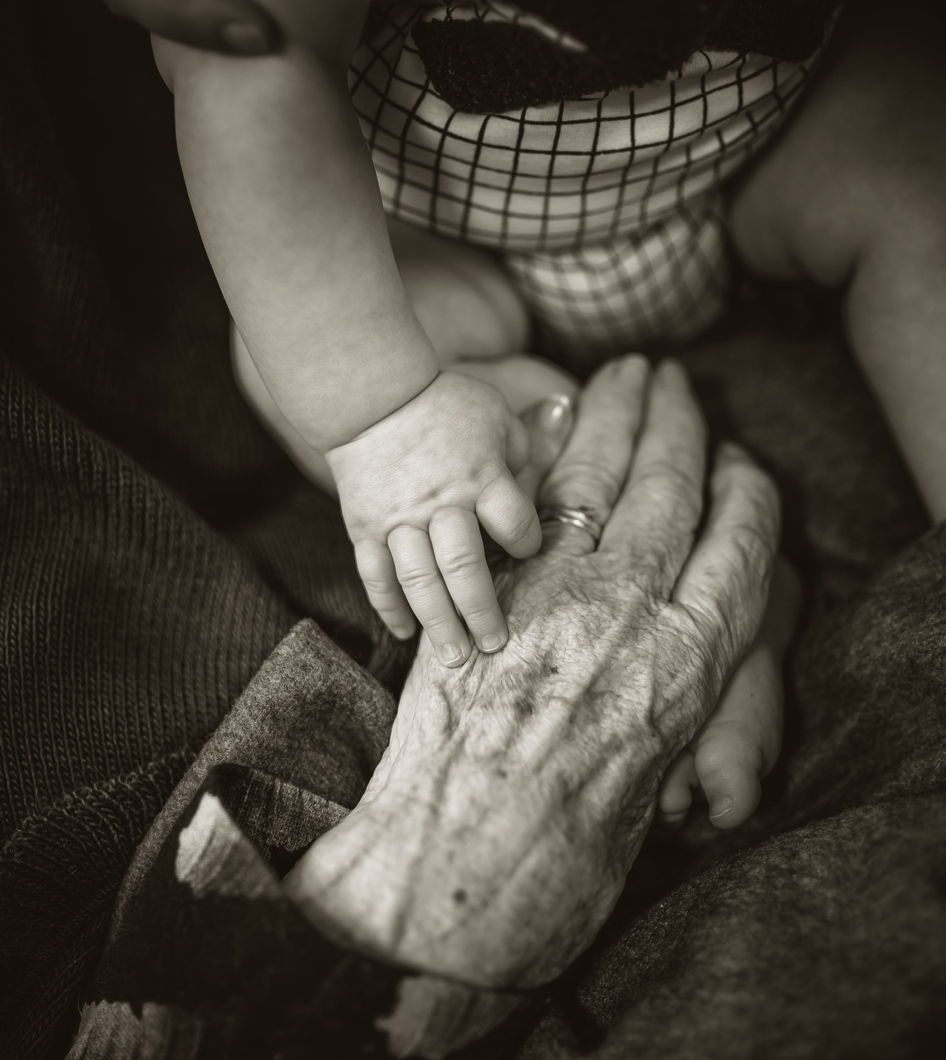
Spiritual issues in Old Age
Regret
Sadness
Fear
Loneliness
Pain
Letting go
Pride & satisfaction
Joy & Anticipation

Slide 5
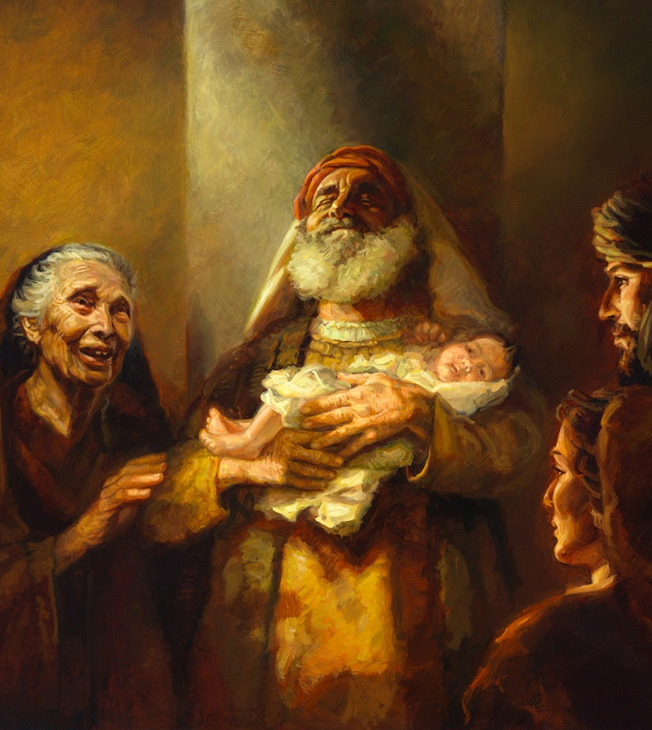
Spirituality of Old Age
Mission
Contemplation
Simeon and Anna
Luke 2:22-38

Slide 6
Spirituality of Old Age
Redemptive Suffering
In my flesh I am filling up what is lacking in the afflictions of Christ.
Col 1:24

Slide 7
Ethical Considerations
…from conception to natural death
What is natural death?

Slide 8
Ethical Considerations
Ordinary vs. extraordinary means
Benefit vs. Burden

Slide 9
Ethical Considerations
Pain management
Double effect

Slide 10
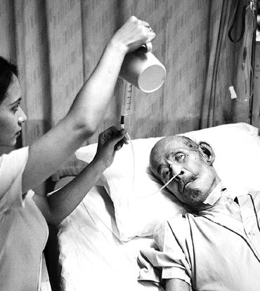
Ethical Considerations
Nutrition and hydration

Slide 11
Ethical Considerations
Quality of Life

Slide 12
Ethical Considerations
MOST and POLST

Slide 13
Footnote
Ministry to the staff

Slide 14
THANK YOU!

