Slide 1

Principles for Parish Evangelization

Slide 2
Why create a document on parish evangelization?

Slide 3
Evangelization is in fact the grace and vocation proper to the church, her deepest identity.
She exists in order to evangelize.
Evangelization in the Modern World, #14
St Paul VI

Slide 4
Archdiocese of Denver – “Mission Anchors”
Holy Priests
Equipped Leaders for Mission
Missional Curia

Slide 5
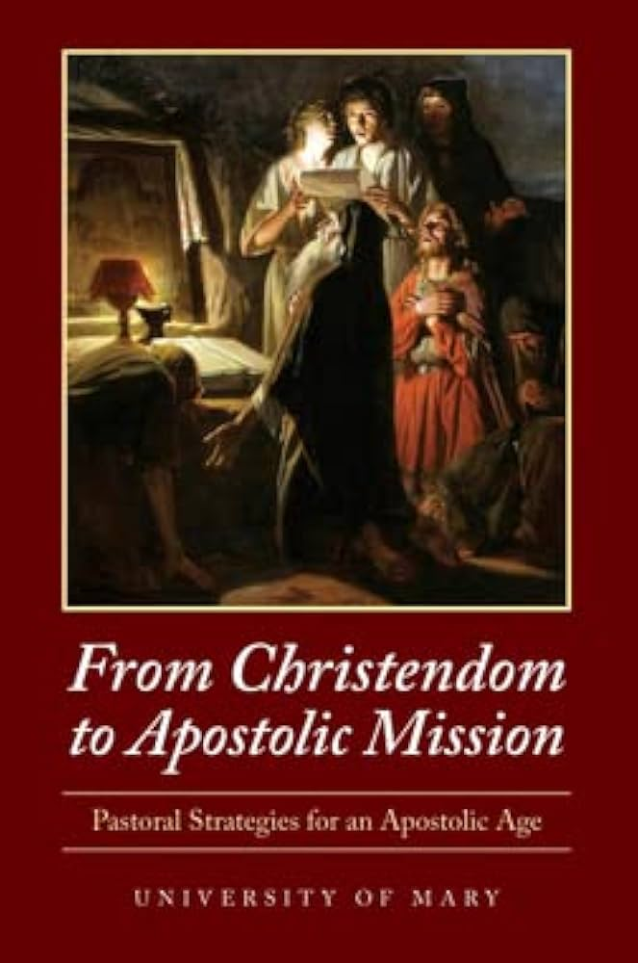
Put on an “Apostolic Mindset”
First Priority?

Slide 6
Initiate, support, and guide robust local conversations about practical evangelization strategies

Slide 7
Principles for Parish Evangelization
Parishioners equipped to evangelize
Pastoral Ministry restructured to support and prioritize evangelization

Slide 8
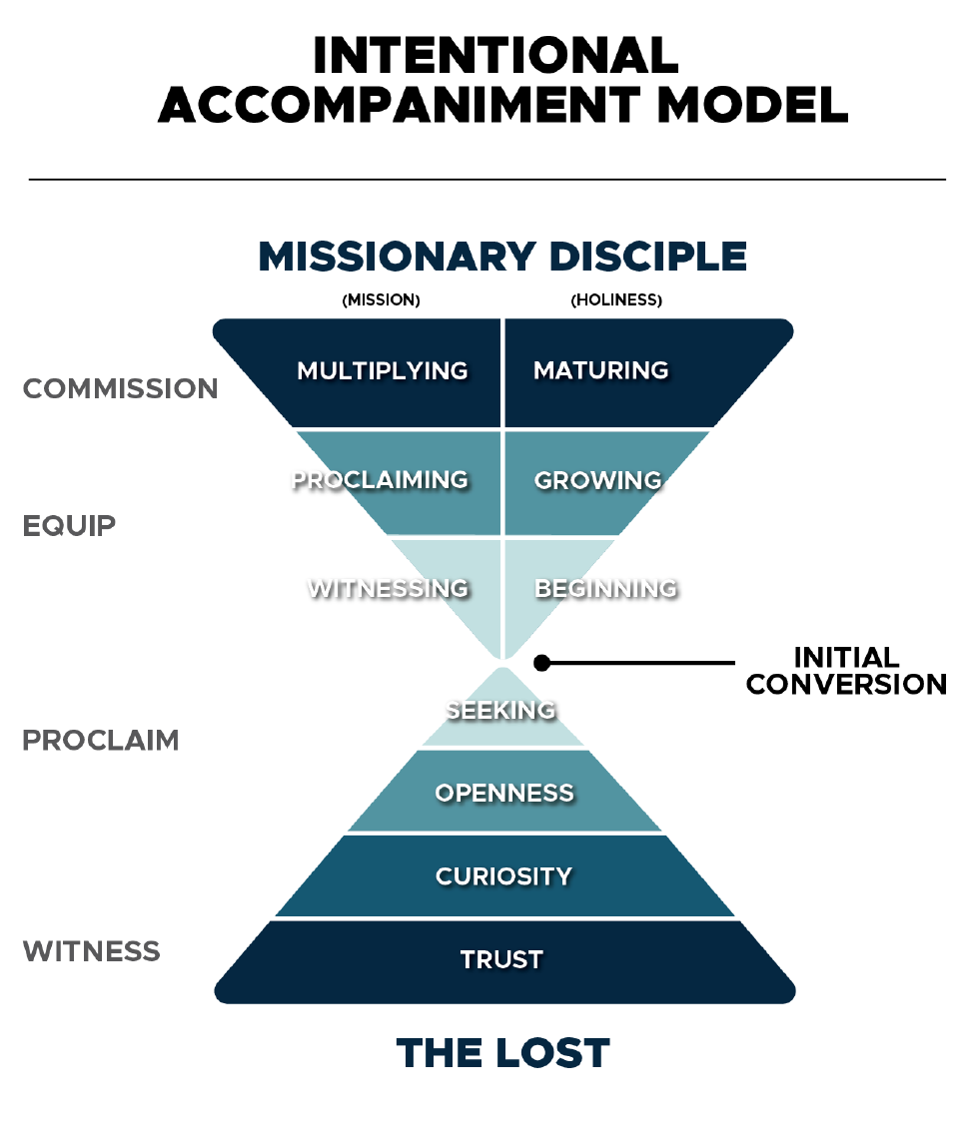

Slide 9
What constitutes an “initial conversion”?
How do you know when one has taken place?

Slide 10
What constitutes an initial conversion?
“Conversion means accepting,
by a personal decision,
the saving sovereignty of Christ
and becoming his disciple”
(St John Paul II, RM #46).

Slide 11
“Faith and conversion arise from the "heart", that is, they arise from the depth of the human person and they involve all that he is.”
General Directory for Catechesis, no. 55
“In the Bible, the heart is the core of the human person, where all his or her different dimensions intersect…intellect, will and affectivity.”
Pope Francis, The Light of Faith, no 26
“Faith is not a merely intellectual, or merely volitional, or merely emotional activity- it is all of these things together. It is an act of the whole self, of the whole person in his concentrated unity.”
-Joseph Ratzinger, Gospel Catechesis Catechism

Slide 12
“Conversion means accepting, by a personal decision, the saving sovereignty of Christ and becoming his disciple”
(St John Paul II, RM #46).
Intellect – “I understand and believe what was proclaimed to me (the kerygma)”
Will - “I choose to repent and submit my life under Jesus’ lordship and live as his disciple”
Emotions – “I have experienced God’s personal and unconditional love for me”

Slide 13
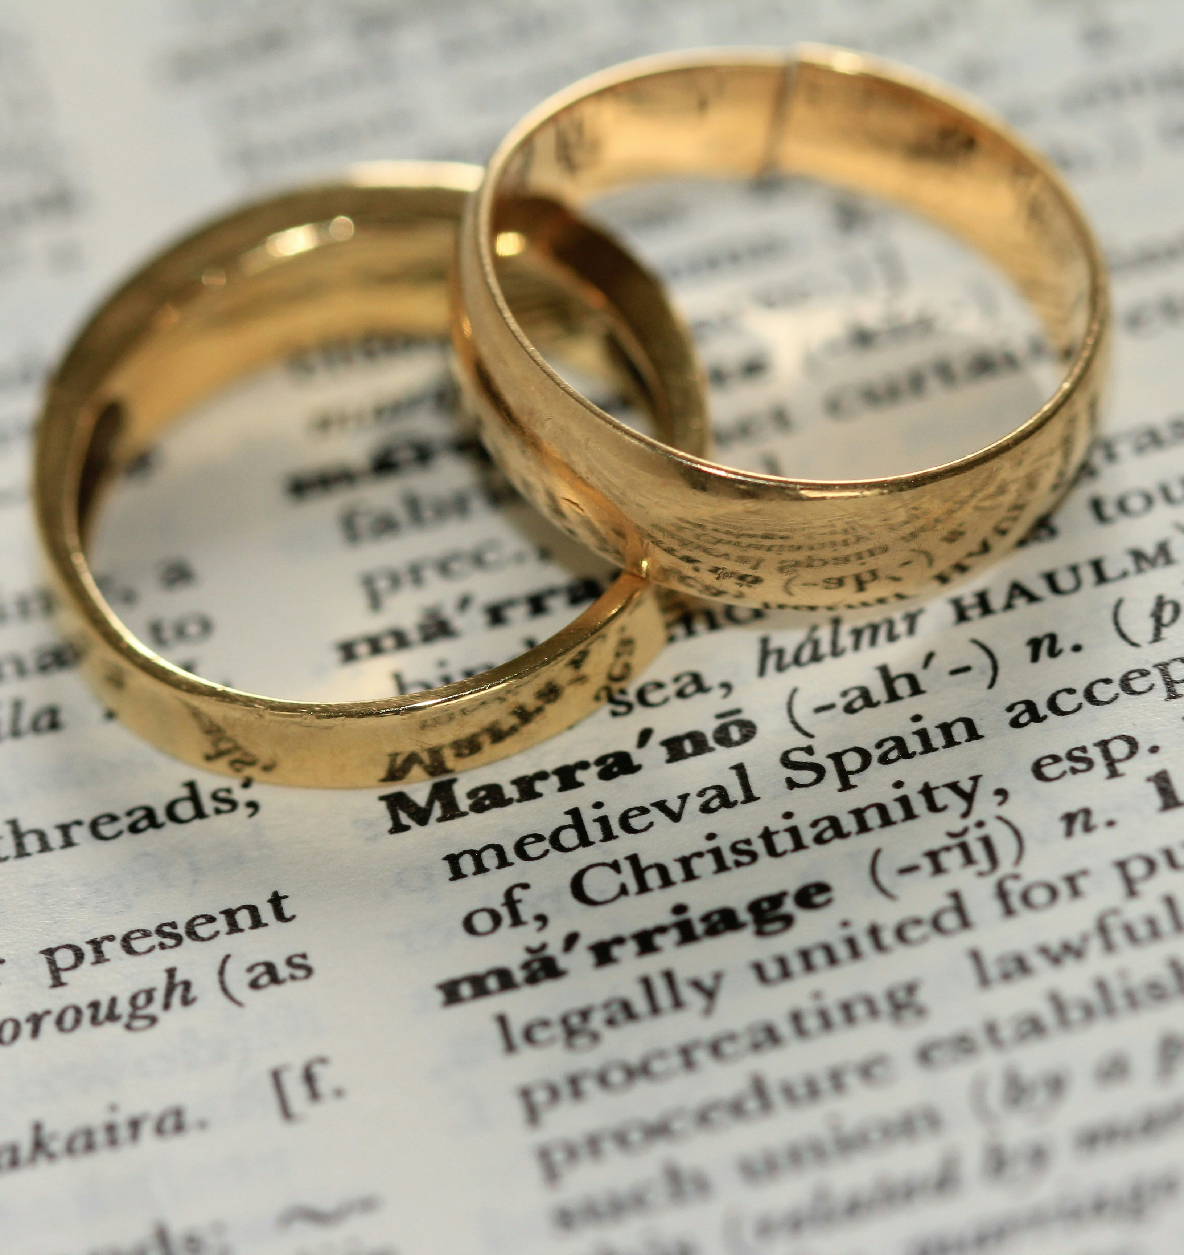
Nuptial Analogy

Slide 14
1) Parishioners Equipped to Evangelize
Wholistic equipping
  A.S.K.
    Attitudes (heart)
    Skills (hands)
    Knowledge (head)

Slide 15
Sharing Testimony (example)
  Attitude
  I believe my testimony is worth sharing
  I believe my testimony can be more powerful that trying to teach my beliefs to someone

Slide 16
Sharing Testimony (example)
  Skill
  I’m able to share my testimony

Slide 17
Sharing Testimony (example)
  Knowledge
  I know what makes an effective testimony

Slide 18
Sharing Testimony (example)
An effective witness…
  (A) I believe my testimony is worth sharing
  (S) I am able to share my testimony
  (K) I know what makes an effective testimony

Slide 19
1) Parishioners Equipped to Evangelize
Maturing in our missional identity happens in stages over time
  “Witness”
  “Proclaim”
  “Multiply”

Slide 23
2) Pastoral Ministry Restructured to Support and Prioritize Evangelization
An analogy…

Slide 24
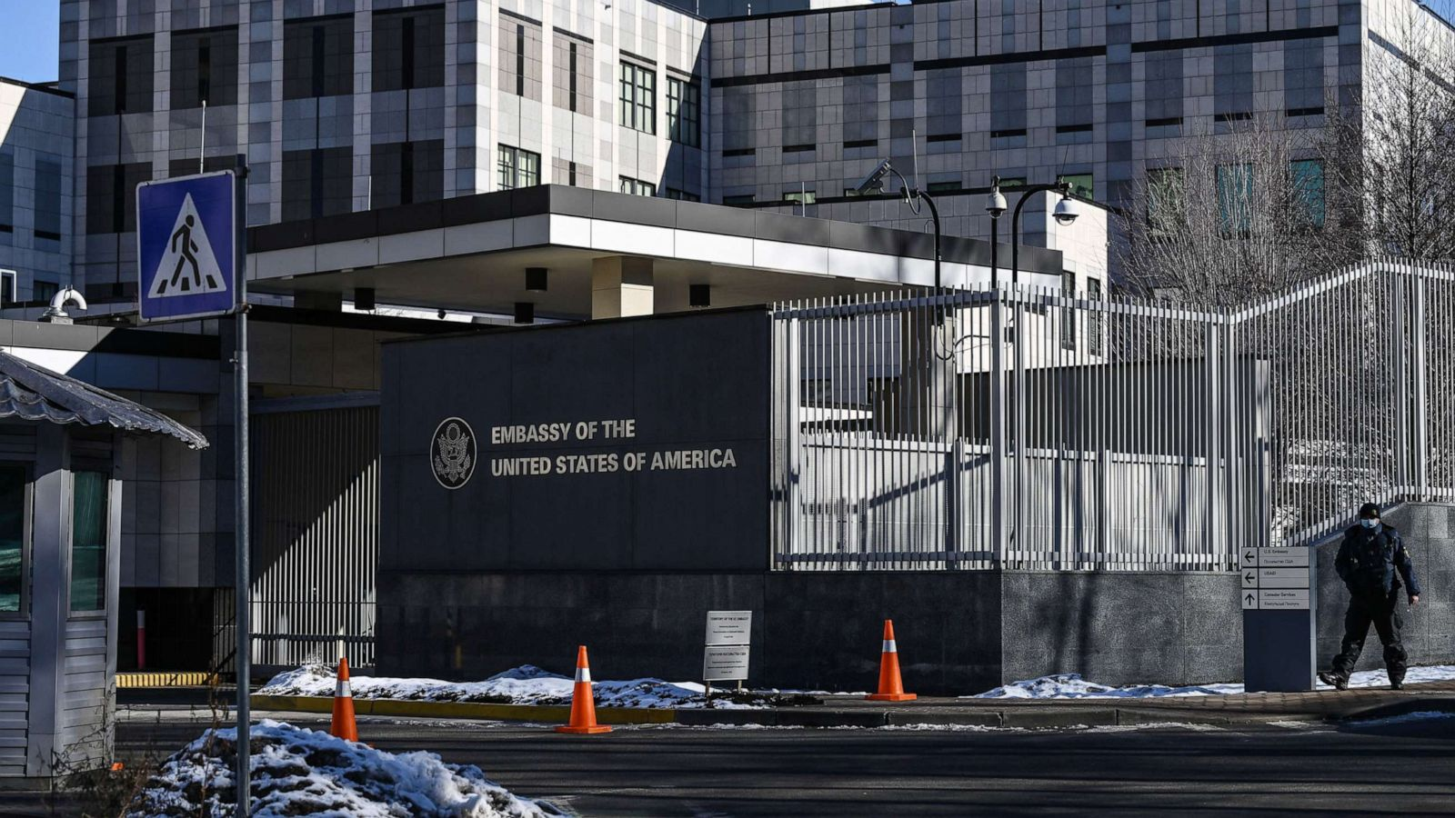

Section One Cover Sample

Slide 25
Parish = embassy of a supernatural kingdom

Slide 26
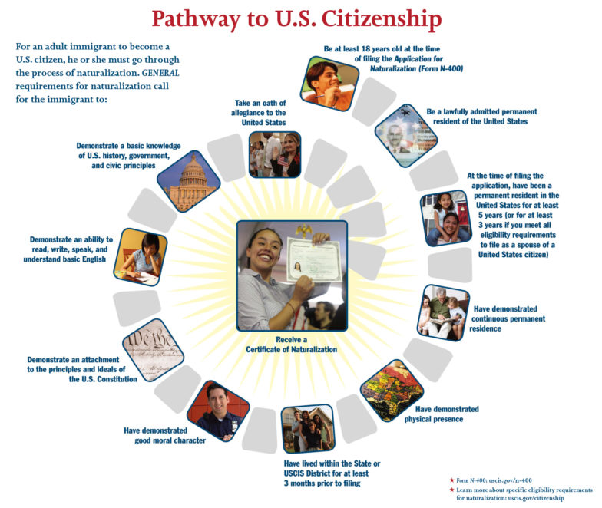

Slide 27
Do we have clarity on the path to “heavenly citizenship”?

Slide 28

Thresholds of Conversion

Slide 29


Slide 31





Slide 32


Slide 33


Slide 34


Slide 35

OCIA
OCIA
Clear, direct personal invitation to conversion
Kerygmatic Retreat
“Journey Group”
“the Search”
“inquire by the fire”
Build Trust

Slide 36
Guiding Questions with Resources

Slide 37

Going in Search of the Lost

Slide 38
Forming an “Evangelization Task Force”

Slide 39
Discussion
What section of this document do you feel would generate the best initial conversation at a staff meeting or with your pastor?
How would you describe your parish’s current efforts to evangelize? What’s working? Where are you struggling?

