Slide 1



Evangelization
& OCIA Workshop
Adult Confirmation
22 January 2026

Slide 2
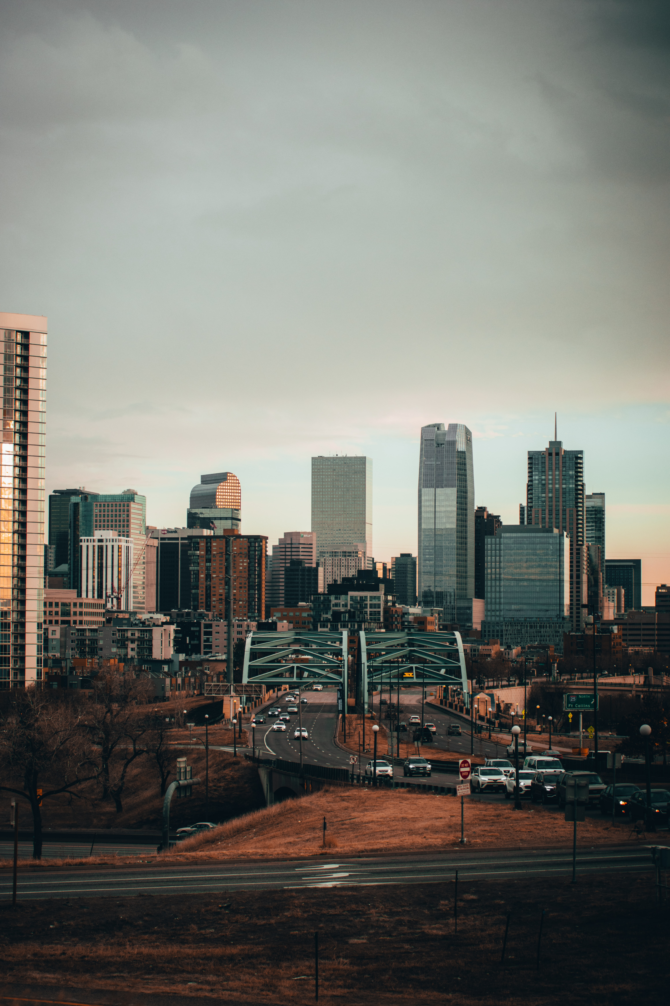
Agenda
Opening prayer
Rite of Election: What to Expect and Q & A with Daniela Muneton
Adult Confirmation: Exploring the Context
What can this look like?
Table Discussion
Save the Date: OCIA Workshop March 19

Slide 3
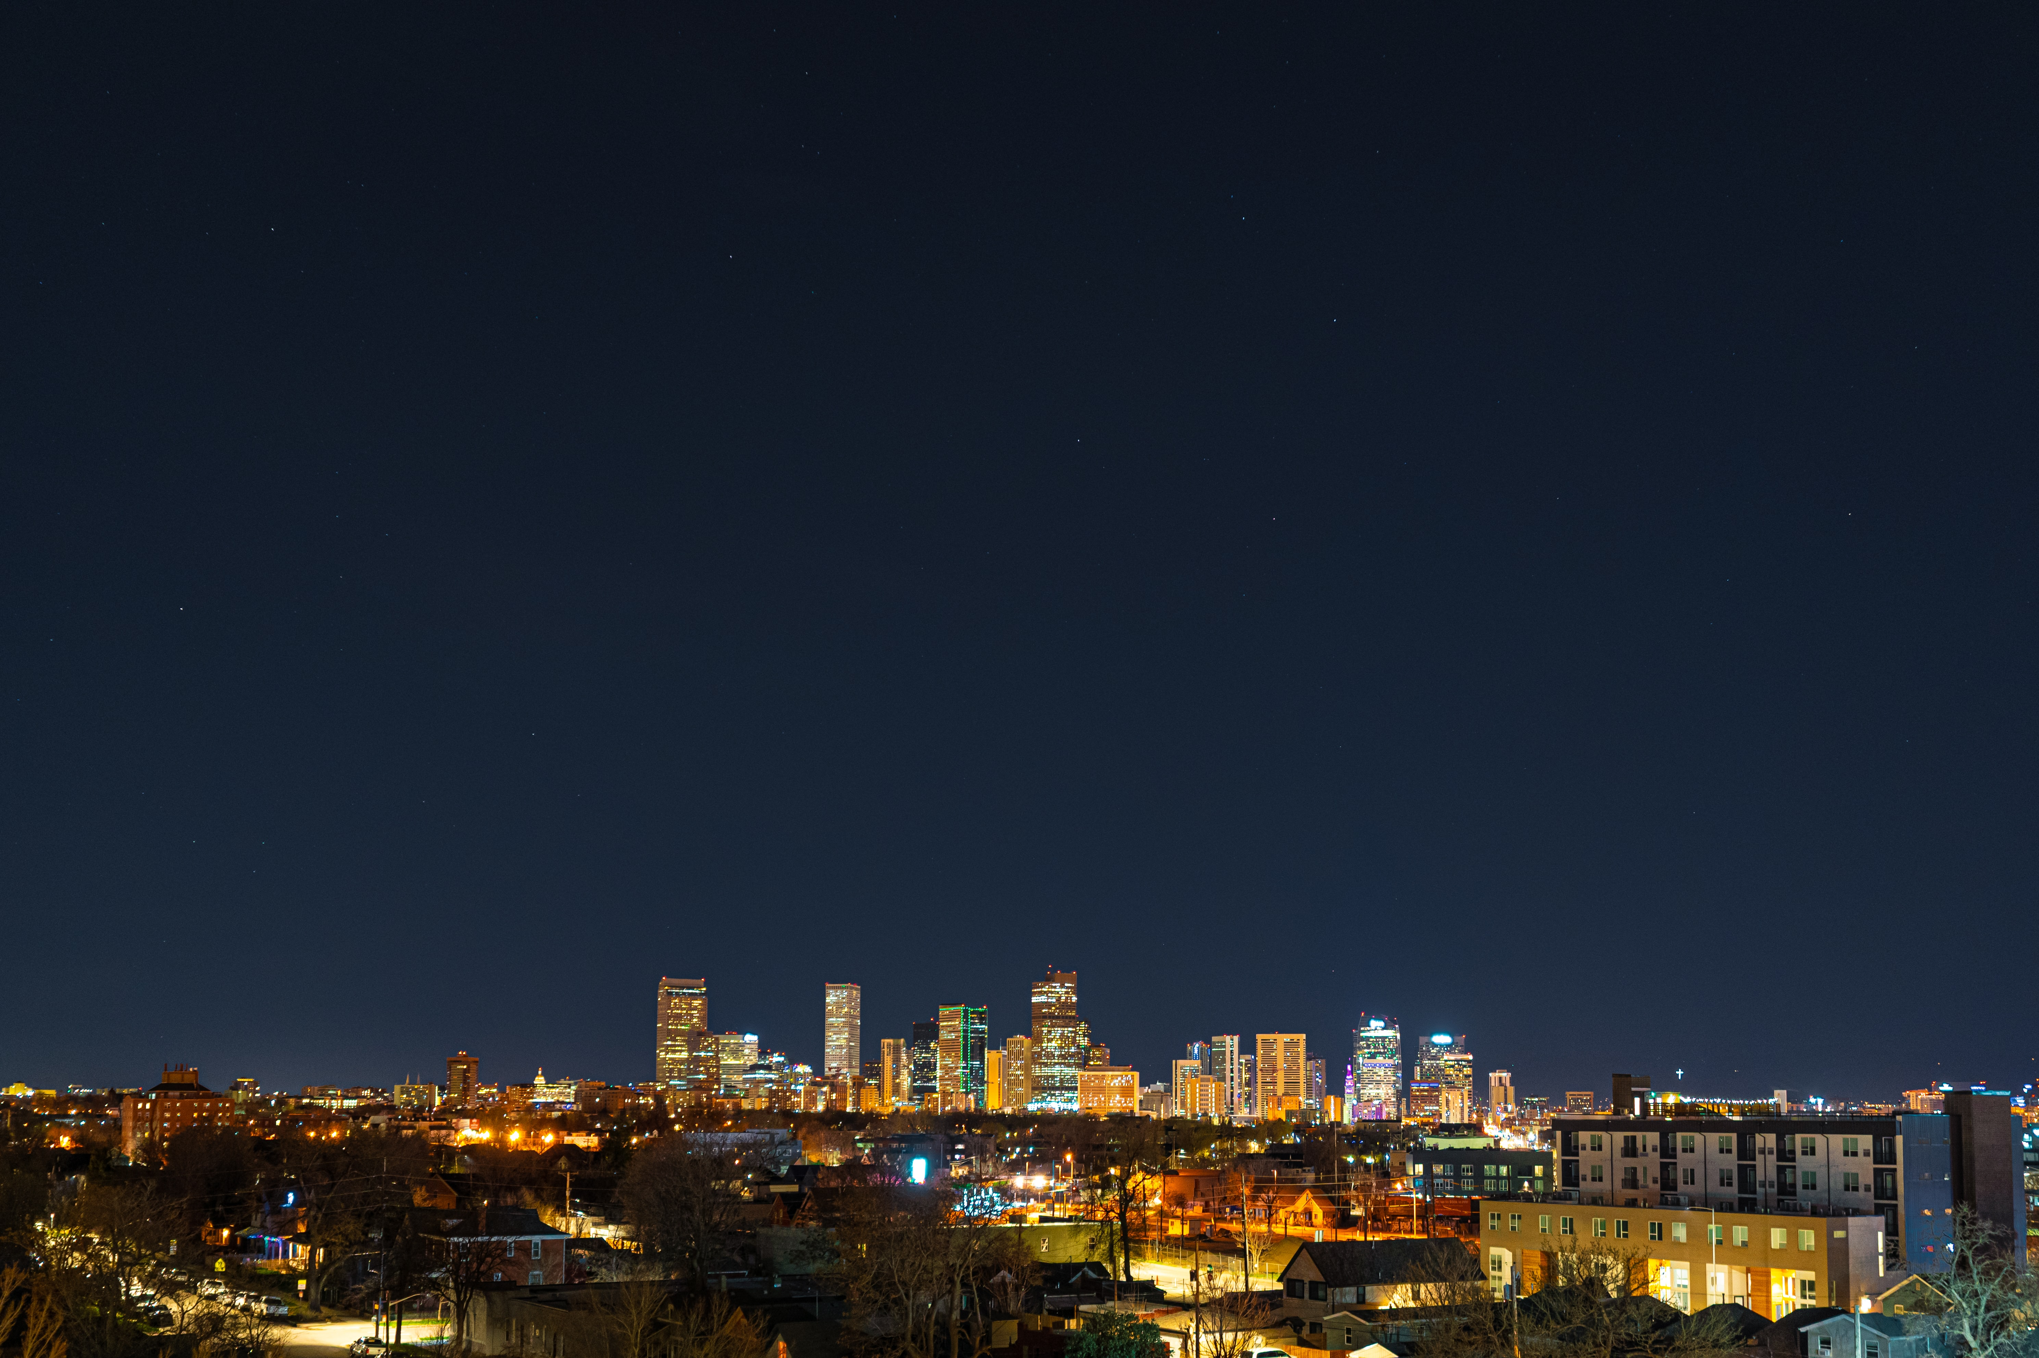

Gospel: Mark 3:7-12
Jesus withdrew toward the sea with his disciples.
A large number of people followed from Galilee and from Judea.
Hearing what he was doing,
a large number of people came to him also from Jerusalem,
from Idumea, from beyond the Jordan,
and from the neighborhood of Tyre and Sidon.
He told his disciples to have a boat ready for him because of the crowd,
so that they would not crush him.
He had cured many and, as a result, those who had diseases
were pressing upon him to touch him.
And whenever unclean spirits saw him they would fall down before him
and shout, “You are the Son of God.”
He warned them sternly not to make him known.

Slide 4
Rite of Election: February 21-22, 2026
Only catechumens, not candidates or confirmandi
Arrive early for a walkthrough of the rite occurring 10 minutes prior to the start of the rite (and to find parking)
Bring your book of the Elect (already signed by the Elect) and please put your parish name in the front cover!!
Note: Please do not enter the cathedral until the previously scheduled Rite of Election has been completed
As seating at the Rite of Election is limited, seating will be reserved for only the catechumens, godparents, and up to 5 catechists per parish
Specific Questions or Concerns?
Email Daniela.Muneton@archden.org

Slide 5
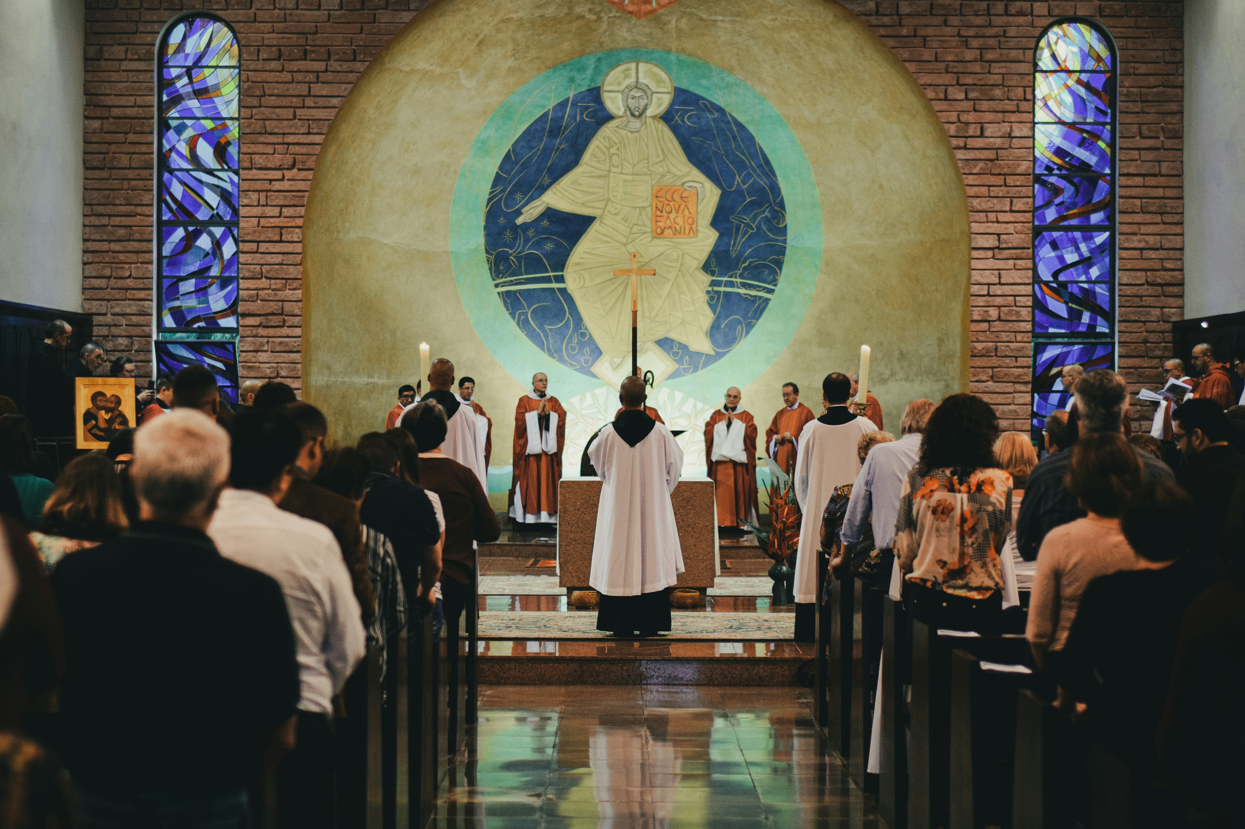
Adult Confirmation:
Let’s Explore the Context

Slide 6
What Category do Adults who Need Confirmation fall into?
Catechized vs Uncatechized?
They Still Need to Be Ready
“Even if adults in this situation have not yet heard the proclamation of the mystery of Christ, their circumstances of catechumens because they have already been brought into the Church and become children of God by Baptism. Hence their conversion is based on Baptism already received, the strength of which they should further develop.” (OCIA 400)
“the preparation of uncatechized adults demands a lengthy period in which the faith poured into them at Baptism ought to grow, in order to attain maturity and be fully formed though pastoral instruction that is handed onto them; their own Christian life must be strengthened by an appropriate formation offered to them, by catechesis adapted for them, contact with the community of the faithful, and participation in certain liturgical rites.” (OCIA 401)

Slide 7
“Readiness” for Confirmation
“the faith poured into them at Baptism ought to grow”
→ practicing their faith, taking part in Eucharist and Confession
“fully formed though pastoral instruction that is handed onto them”
→ walk the walk of a Christian
“their own Christian life must be strengthened by an appropriate formation offered to them”
→ accompaniment in their processing of what it means to be confirmed
“catechesis adapted for them”
→ what they actually need to know to be a 21st century Catholic
“contact with the community of the faithful”
→ they are an active part of the parish community
“participation in certain liturgical rites”
→ The Celebration of their Confirmation is the only requirement!
Notes:
- **Universal Call to Holiness**: Regardless of the era, the laity are called to pursue holiness and live out their faith through various vocations.
- **Missionary Activity**: The laity are always called to be witnesses of Christ, sharing the Gospel through their actions and words.
- **Contributors to Communal Life**: In all times, the Church relies on the diverse gifts and presence of the laity to enrich and build up the Body of Christ.

Slide 8

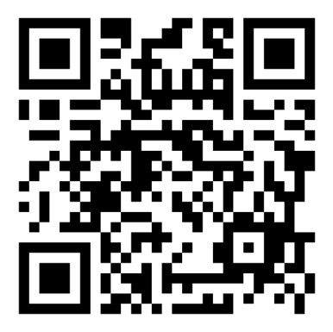
Break
Didn’t do the survey yet? It would be v cool of you to fill it out:

Slide 9
What Can this Look Like?
Experiences at IHM with Deacon Paul Louderman
Notes:
- **Universal Call to Holiness**: Regardless of the era, the laity are called to pursue holiness and live out their faith through various vocations.
- **Missionary Activity**: The laity are always called to be witnesses of Christ, sharing the Gospel through their actions and words.
- **Contributors to Communal Life**: In all times, the Church relies on the diverse gifts and presence of the laity to enrich and build up the Body of Christ.

Slide 10
Demographic information based on 50 students for the first two programs offered in the fall and winter at IHM:
Gender: 39 females to 21 Males
Age:
  50% are 18-34
  30% are 35-54
  20% are 55+
About half of the students are from IHM, the rest are from other parishes in Thornton, Brighton, Commerce City, Westminster, Denver, Littleton and Aurora

Slide 11
Table Discussion:
Have you considered how many un-confirmed adults are in your pews on Sunday?
How would having a confirmation-only track impact your OCIA group?
Are there other more specific needs (other than confirmation only) that you see in your group?
Convalidation & OCIA?
Marriage Prep & OCIA?
Whole Family OCIA?
Fallen away Catholics that we don’t know where else to put?

Slide 12


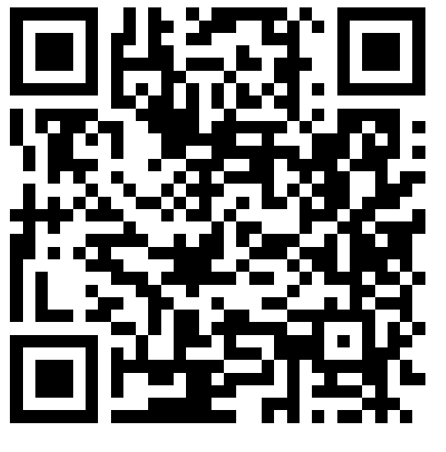
Save the Date: Evangelization & OCIA
Please take the OCIA/Evang Survey:
Upcoming Workshops/Meetings:
March 19- Mystagogy
May 21- Engaging OCIA in the Summer Months
Not Getting Our Newsletters? Sign Up Here!

