Slide 1
Interviewing Best Practices for Parishes
Mission, Method, and Mistakes to Avoid
By Jim Baker, Director of HR
For Parish Business Managers
Feb 11, 2026
Notes:
Welcome both in‑room and Zoom participants. Acknowledge the hybrid format and invite Zoom attendees to use chat actively.

Slide 2
Set The Stage - Visualization
Think back to a recent / your last interview you participated in . . .
Did the questions you asked separate good candidates from great ones?
Was the hiring decision made based on the way the candidates answered the questions or by some other data points?
Call to mind the best interview question you have been asked or have asked in the past . . . write it down!

Slide 3
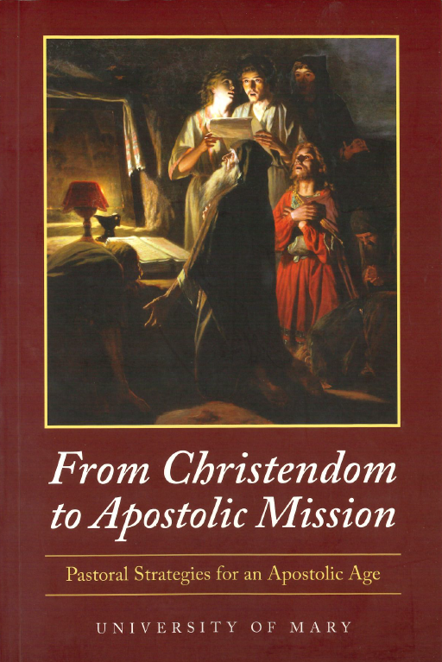
From Christendom to Apostolic Age
Christendom:
  Church at the center of culture; faith assumed
Apostolic Age:
  Church on the margins; faith must be intentional
Our parish systems were built for Christendom
We are called to rethink how we operate in this Apostolic Age
Notes:
Keep this high-level and practical. Emphasize lived parish reality rather than theory.

Slide 4
Why This Matters for Hiring
Parish staff are not just employees
Every role supports the mission of the Church and your parish
Skills without mission alignment create friction and prevent mission achievement
Notes:
Frame this as something business managers influence daily, even without clergy present.

Slide 5
Interviewing with a Mission Lens
Can the candidate do the job? (Requirements)
Will they do it well? (Skills)
Will they support and advance the parish mission? (Living in Mission)
Notes:
Use inclusive language: 'we' and 'our parishes.' Pause briefly for Zoom chat reactions.

Slide 6
The One Rule to Remember
Every interview question must be job-related
If it doesn’t relate to the role, don’t ask it
Notes:
Reinforce that job-related questions help managers feel confident and consistent.

Slide 7
Questions You Must Avoid
Age
Family or marital status
Health or disability
National origin or language
Notes:
Normalize mistakes—this is about improvement, not fear.

Slide 8
Age-Related Questions
Do not ask age or graduation year
Do not ask about retirement
Do not ask any questions that could be construed as age related
Instead: Ask about ability to meet job requirements
Notes:
Use examples managers will recognize from real interviews.

Slide 9
Family & Marital Status
Do not ask about children or childcare
Do not ask about spouse or family plans
Instead: Ask about schedule availability
Notes:
Emphasize scheduling language; give Zoom attendees time to post alternatives in chat.

Slide 10
Health & Disability
Do not ask about medical conditions
Do not ask about sick leave history
Instead: Ask about ability to perform essential functions
Notes:
Explain ADA phrasing clearly; avoid legal jargon.

Slide 11
More Questions To Avoid
Where do you live?
Where did you grow up?
Is that your maiden name?
What does your spouse do?
Any question that could connect a candidate to a protected class should be avoided.
Take Away: Friendly does not mean appropriate
Notes:
This slide works well for quick chat responses: 'Have you heard these before?'

Slide 12
If a Candidate Volunteers Sensitive Information
Do not follow up
Redirect to job-related topics
Do not document personal details
Notes:
Model a redirect phrase out loud for both audiences.

Slide 13
Protecting The Process
Use prepared questions
Try to have the same interviewees for all candidates
Ask the same core questions of all candidates
Take objective notes
Involve HR early if any irregularities arise
Notes:
Frame process as a support for managers, not a burden.

Slide 14
Move from Christendom to Apostolic Age Interview Questions
Commitment to Mission
Christendom/Secular Approach:
"Tell us about your previous work experience and how it has prepared you for this role."
Apostolic Approach:
"How has your professional and personal journey prepared you to serve in a role that supports the mission of the Church? Can you share an experience where you lived out your faith in your work?"
Handling Challenges
Christendom/Secular Approach:
"Describe a time you had to resolve a conflict in the workplace. What steps did you take?"
Apostolic Approach:
"Tell us about a time when you encountered a challenging situation in a ministry or work setting. How did you approach it in a way that reflected Christian values and built up the community?"

Slide 15
Move from Christendom to Apostolic Age Interview Questions
Evangelization & Hospitality
Christendom/Secular Approach:
"How do you handle customer service and ensure good communication with colleagues and clients?"
Apostolic Approach:
"The Church is called to be a place of radical hospitality. How would you ensure that every person you interact with, whether in person, over the phone, or via email, experiences the love of Christ through their encounter with you?"

Slide 16
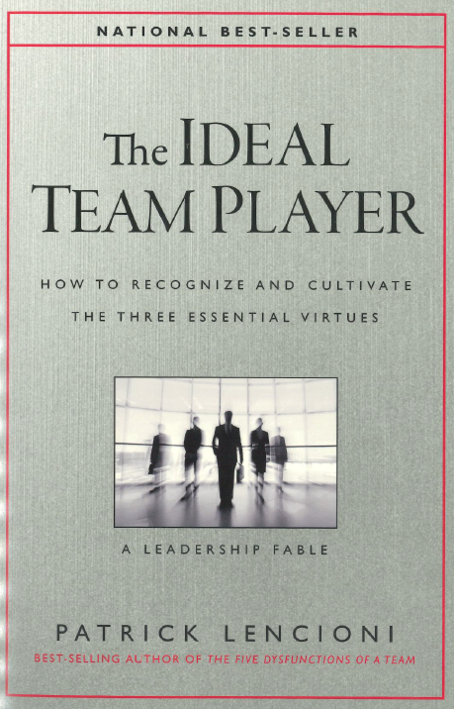
A Great Interview Resource
Patrick Lencioni
Think: Working Genius and Table Group

Slide 17
Humble, Hungry, Smart (with an Apostolic Slant)
Humble (Values teamwork, serves others, lacks arrogance)
Lencioni’s Suggested Question:
"Tell me about the most important accomplishments of your career."
Apostolic Adaptation:
"Tell me about an accomplishment you’re proud of, and how others contributed to that success. How do you see your strengths as a way to serve the Church and its mission?"

Slide 18
Humble, Hungry, Smart (with an Apostolic Slant)
Hungry (Self-motivated, takes initiative, goes above expectations)
Lencioni’s Suggested Question:
"What is the hardest you have ever worked on something?"
Apostolic Adaptation:
"Tell me about a time when you went beyond what was expected of you, not because you had to, but because you believed in the mission of the work. How do you stay motivated when challenges arise?"

Slide 19
Humble, Hungry, Smart (with an Apostolic Slant)
Smart (Emotionally intelligent, good judgment in relationships)
Lencioni’s Suggested Question:
"Have you ever worked with someone who struggled to work well with others? How did you handle it?"
Apostolic Adaptation:
"Ministry and parish work involve collaboration with a variety of personalities. Tell me about a time when you had to navigate a challenging interpersonal situation while maintaining a Christ-like attitude. How did you handle it?"

Slide 20
Think Back . . .
Recall the interview question you wrote down at the start of this presentation.
How can you reword that question to include a more apostolic/mission slant?
Share to first and reworded question . . .

Slide 21
Final Takeaways
Interviewing is mission work.
Mission-aligned questions should be asked and must still be job-related.
Good processes protect the integrity of your decisions and your parish.
Notes:
Close by affirming their leadership role even without clergy present.

Slide 22
Case Study 1: Mission Fit
A candidate has excellent skills but shows little interest in parish mission.
Discussion:
  What concerns you?
  What follow-up questions could you ask?
  Would this be a deal-breaker?
Notes:
Invite table discussion for 3–5 minutes, then debrief with the group.

Slide 23
Case Study 2: The Friendly Question
An interviewer asks, 'Do you have kids?' to build rapport.
Discussion:
  Why is this a problem?
  What could have been asked instead?
  How do we coach volunteers who interview?
Notes:
Invite table discussion for 3–5 minutes, then debrief with the group.

Slide 24
Case Study 3: Candidate Volunteers Information
A candidate shares a medical condition during the interview.
Discussion:
  How should the interviewer respond?
  What should be documented?
  When should HR be involved?
Notes:
Invite table discussion for 3–5 minutes, then debrief with the group.

