Slide 1

Job Posting Best Practices
Mission, Method, and Mistakes to Avoid

Slide 2
Objectives
Understand where to access Recruiting
Create a new job requisition
Publish and manage the job
Job Description Requirements
Screening Tips
View and Contacting Applicants

Slide 3


Access the Recruiting Module
Log into Paylocity
Navigate to the hamburger icon in the left-hand corner
Navigate to Recruiting

Slide 4

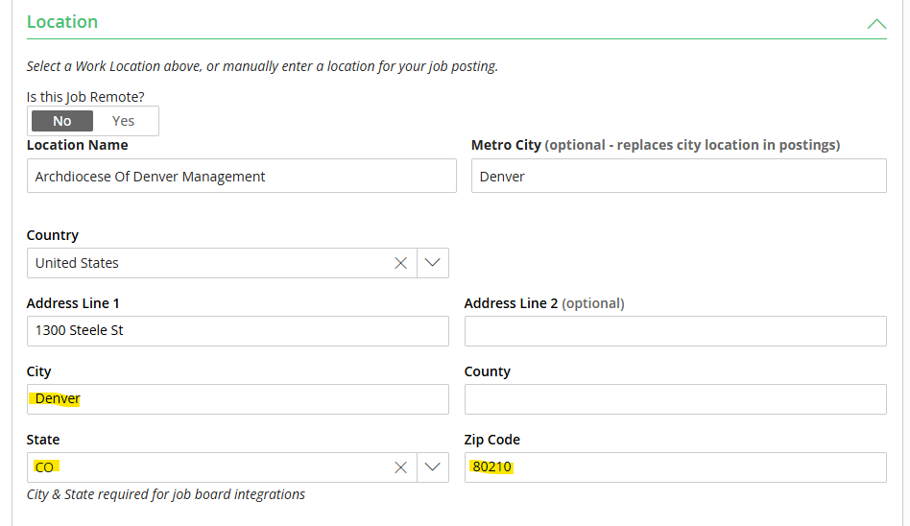
Create a New Requisition
Click on Create New Job in the right-hand corner
Enter the basic job information
  Location name
  City, state, and zip code are required for the role to integrate properly with the job board.

Slide 5
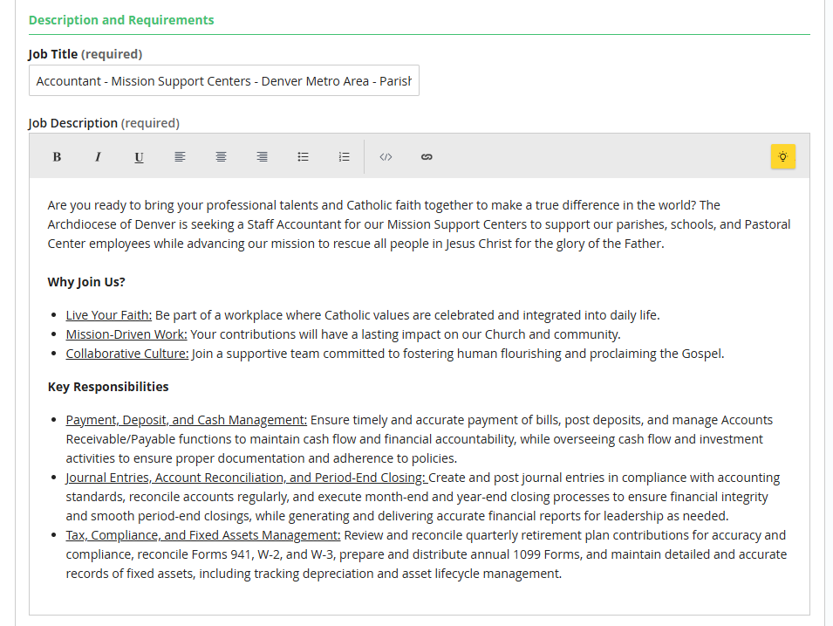
Enter Job Details
Job Title
Job Description
  Key Responsibilities

Slide 6
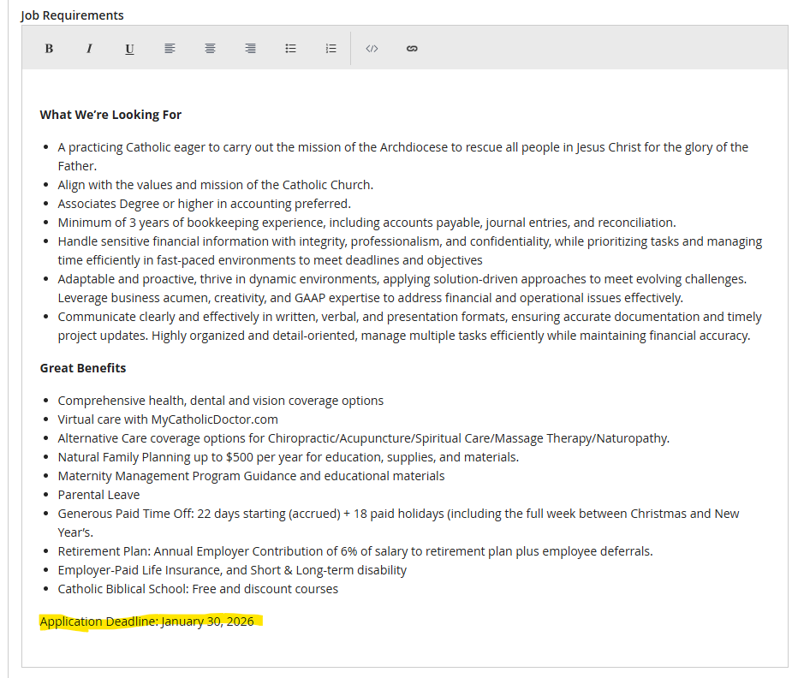
Enter Job Details – cont.
Job Requirements and qualifications
Add benefits
Include Application Deadline

Slide 7
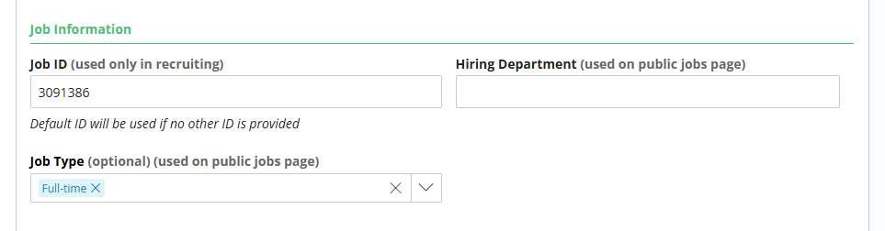
Job Information
A default ID will be used if no ID is provided for the Job ID
Hiring Department and Job Type are optional fields

Slide 8
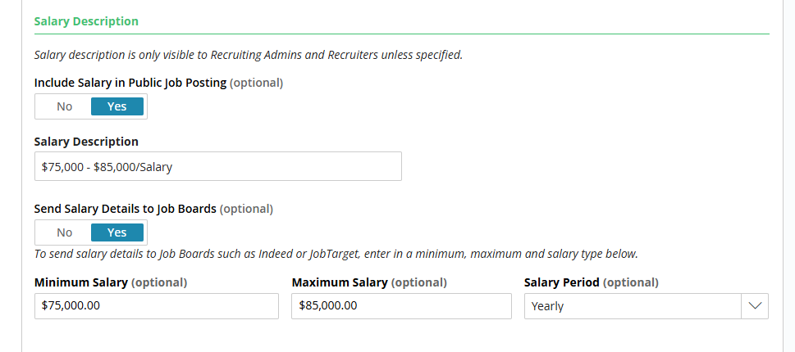
Salary Description
This is a requirement in the state of Colorado. All job postings must include a salary range!

Slide 9
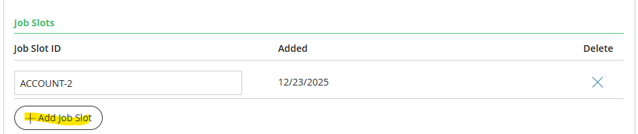

Job Slot
Ensure you are adding a Job Slot ID by clicking on Add Job Slot.
After this has been completed click Next: Hiring Process

Slide 10
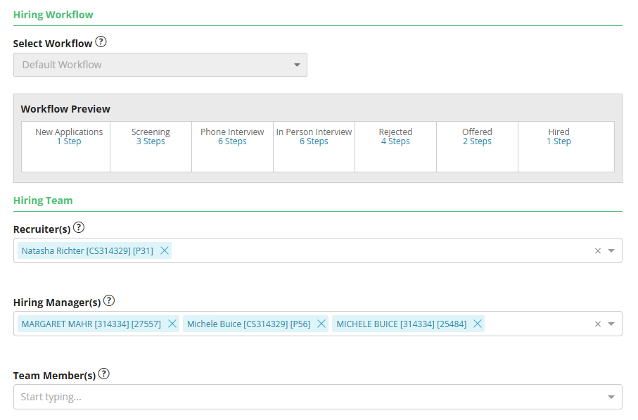
Set Hiring Workflow
Assign recruiters and hiring managers here

Slide 11
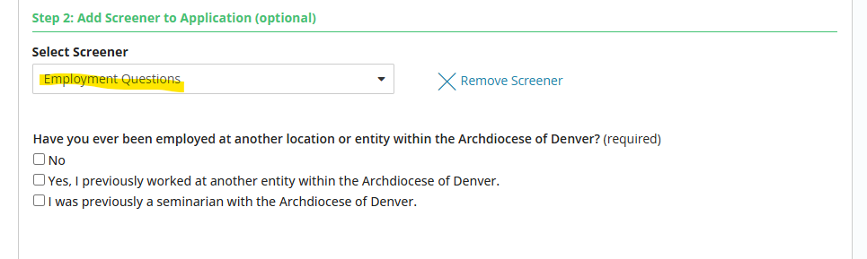
Application & Screener Questions
Ensure the application is set to General Application (Default)
Make sure you are adding the Employment Questions in Step 2

Slide 12
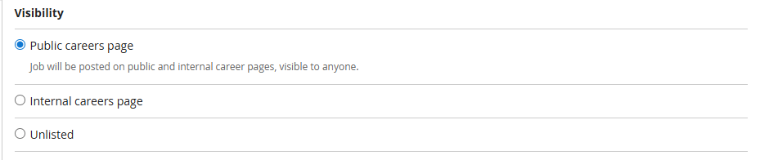
Job Preview and Status
Under job status make sure that Public careers page is selected.
Use Preview Job Posting to see how your job post will appear. To make changes, return to the Job Information tab.

Slide 13


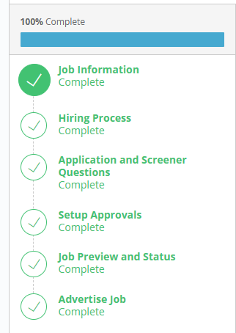
Access the Recruiting Module
From the Job Preview & Status section, click on Next: Advertise Job
From the Advertise Job Section just click on Return to All Jobs
Once all steps are completed, the entire process will be complete.

Slide 14
Job Description Requirements
Must include the following in every job posting (internally or externally) that is subject to Colorado’s law:
Compensation Information
  Include the rate of pay or a pay range (e.g., hourly wage or annual salary). The range must have a minimum and maximum that the employer reasonably believes it might pay for the role.
  Avoid the use of open-ended terms like “$20/hr. and up” without an upper end.
  A general description of bonuses, commissions, tips, stipend, or other forms of compensation must be included if offered.
Benefits
  A general description of all benefits the job offers; such as health insurance, retirement plans, paid time off (including sick or parental leave), etc.
  Minor perks (e.g., EAP, employee discounts) are not required but core benefits must be listed.
Application Information
  Colorado guidance also emphasizes employers must show how (and, under recent amendments, by when) applicants should apply, like application methods and deadlines.

Slide 15
Job Description Requirements – cont.
Internal Posting Requirements
  Employers must also notify current Colorado employees of job opportunities before or at the same time as any external posting. This applies to promotions or vacancies where internal candidates might be interested.
  Internal notices must include the same basic information (compensation range, benefits, application method).
Additional Tips for Employers
  Use inclusive, non-discriminatory language in job ads to avoid undue barriers.
  Ensure any minimum qualifications are genuinely job-related and not proxies for protected characteristics.

Slide 16
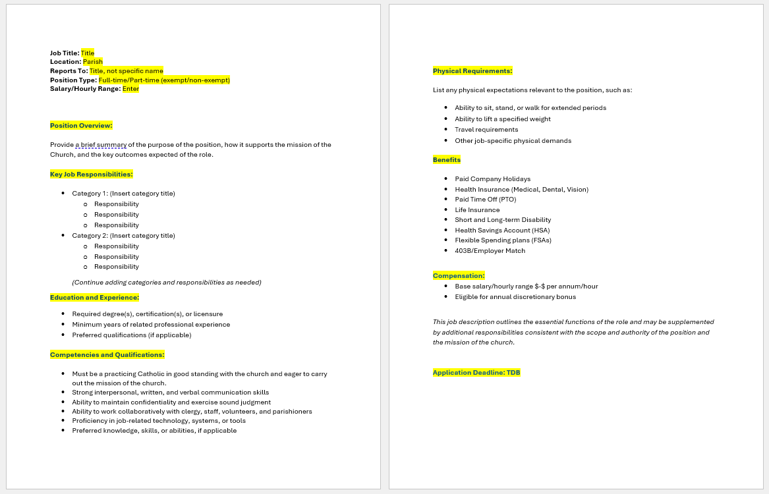
Job Description Template

Slide 17


Screening Tips
General Interview Best Practices:
Ask the same core questions of all candidates for the same position to ensure fairness and consistency
Keep questions job-related, mission-related, and competency-based
Focus on skills, experience, behavior, and alignment with the role’s responsibilities
Avoid questions about protected characteristics.
Document interview responses objectively and consistently
Questions to include:
Ask questions that assess alignment with the mission, teaching, and values of the Catholic Church.
Ask candidate to connect their background directly to the job duties.
Use past behavior to predict future performance.
Questions to avoid:
Avoid question about age, marital status, family planning, pregnancy, medical conditions, disability or national origin
Avoid questions that could be interpreted as discriminatory rather than mission related

Slide 18
Sample Questions
How do you see this role supporting the mission of the Catholic Church
Describe your experience working in a faith-based or mission-driven organization
Tell us about your experience performing duties similar to those outline in this position.
What skills or qualifications best prepare you for this role.
Describe a time you worked collaboratively with a team.
How do you handle disagreements in a professional and respectful manner?
How would you respond to a parishioner who is upset?
How do you ensure compliance with policies and procedures?
Are you able to perform the essential functions of this position?

Slide 19

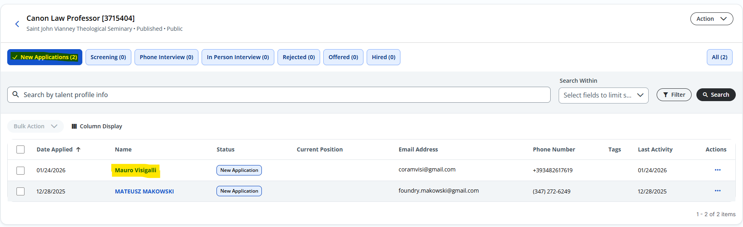
View, Selecting and Communicating
with Applicants
Once you login to Paylocity got to the hamburger icon then go to:
Recruiting > Jobs Dashboard > Click Job Title
View list of applicants
Click on applicant’s name

Slide 20
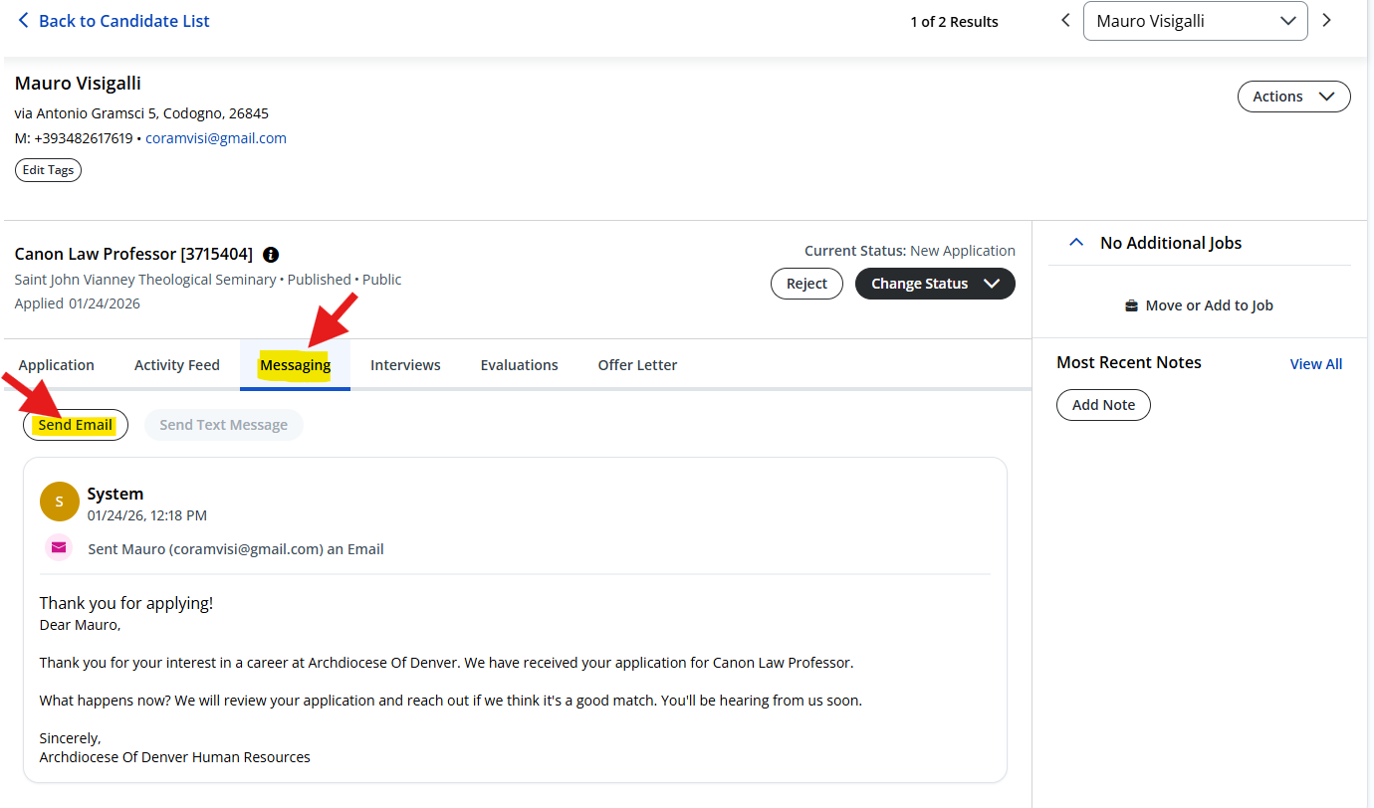
View, Selecting and Communicating
with Applicants – cont.
Access the applicant’s profile
View the submitted application
Go to message tab
Contact applicants directly
  Email
  Text message (if applicant has opted in)

Slide 21
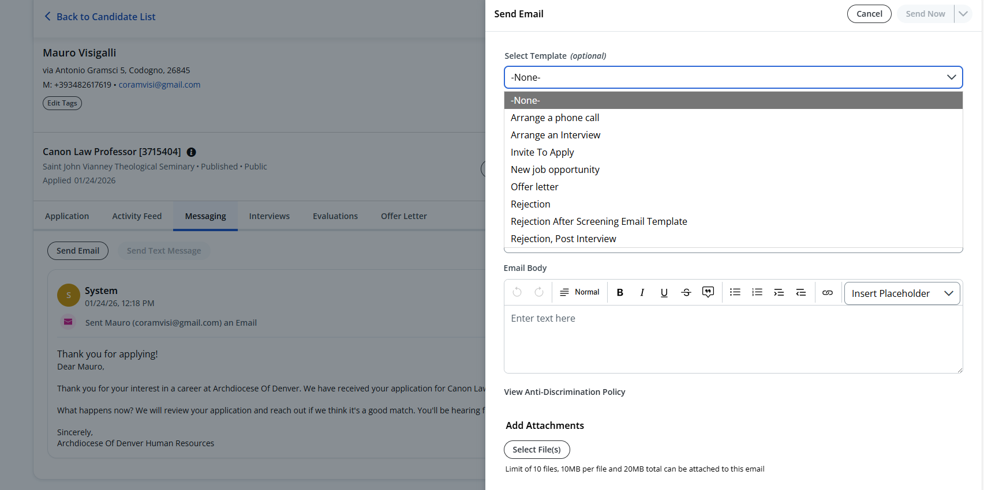
View, Selecting and Communicating
with Applicants – cont.
Select from one of the templates or write your own message.
If you select a template, you can customize message.
Send email to applicant(s).
  Schedule Phone Interviews
  Schedule In-person Interviews
  Ask for more information
  Reject candidate
  Offer Job

Slide 22
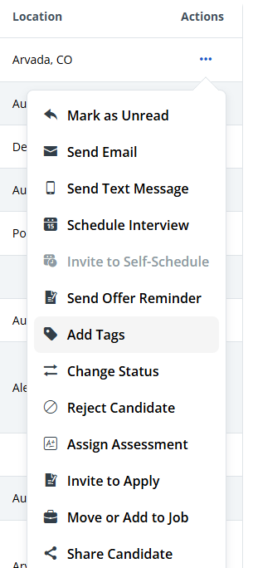



Recruiting Tools & Resources
Track your progress throughout the recruiting process
Update applicant statuses to move candidates through each stage
Create and apply tags to organize and identify applicants
Mark candidates as Hired and send their New Hire Checklist through the recruiting module

Slide 23
Thank you!

