Slide 1



Evangelization
& OCIA Workshop
Mystagogy
19 March 2026

Slide 2

Agenda
Opening prayer
Sacramental Statistics
Mystagogy: What is it?
break
What can this look like?
Save the Date: OCIA Day of Reflection

Slide 3

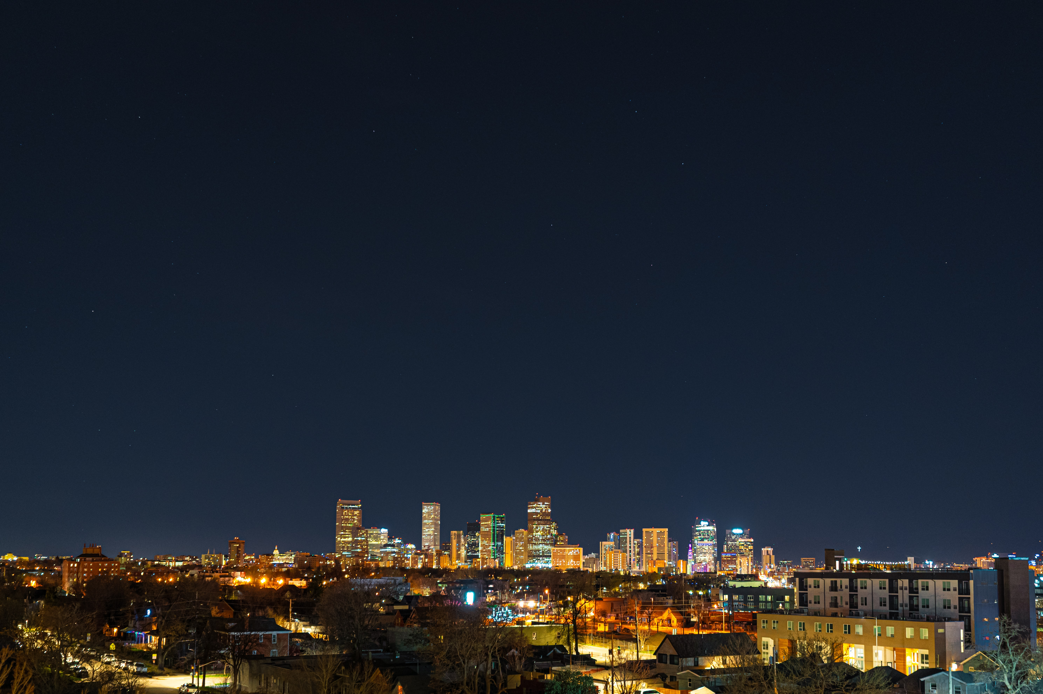
Second Reading: Romans 4:13, 16-18, 22
Brothers and sisters:
It was not through the law
that the promise was made to Abraham and his descendants
that he would inherit the world,
but through the righteousness that comes from faith.
For this reason, it depends on faith,
so that it may be a gift,
and the promise may be guaranteed to all his descendants,
not to those who only adhere to the law
but to those who follow the faith of Abraham,
who is the father of all of us, as it is written,
I have made you father of many nations.
He is our father in the sight of God,
in whom he believed, who gives life to the dead
and calls into being what does not exist.
He believed, hoping against hope,
that he would become the father of many nations,
according to what was said, Thus shall your descendants be.
That is why it was credited to him as righteousness.

Slide 4
Sacramental Statistics from 2025
1286
547 8-17 years old
417 18+ years old

Slide 5
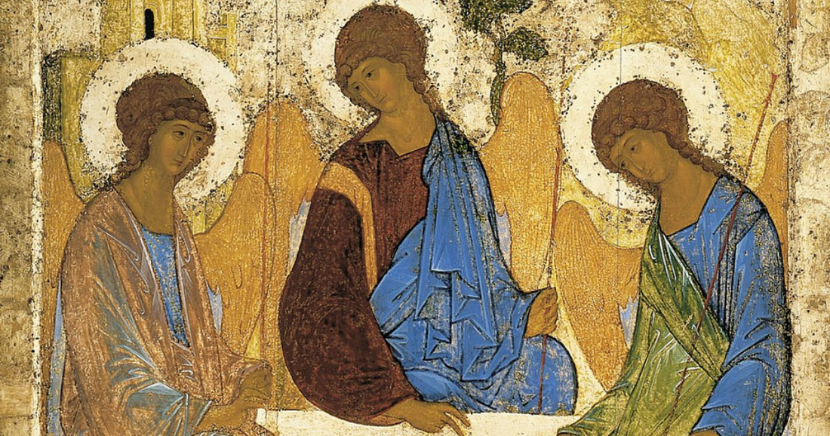
Mystagogy

Slide 6


Slide 7
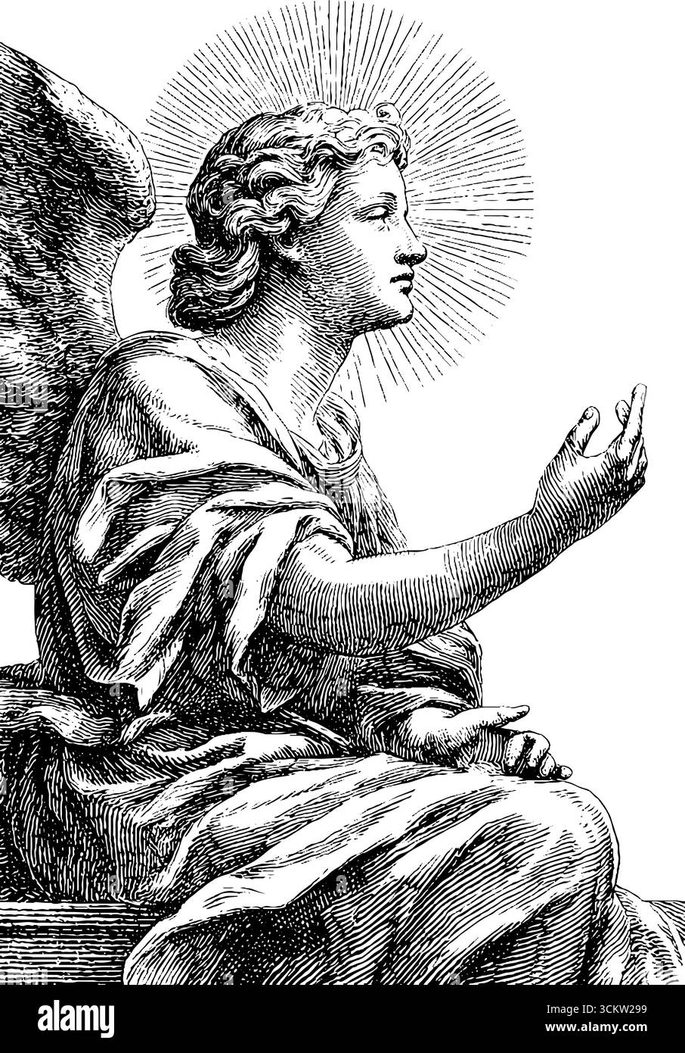
Survey Results: What is Mystagogy?
Ongoing Growth/Lifelong Journey (31%)
Post-Sacramental Time Period (28%)
Reflection on Sacraments now Received (16%)
Integration into the Christian Community (16%)
Instruction/Continued Education time (12%)
Revelation of the Mystery of God (9%)

Slide 8
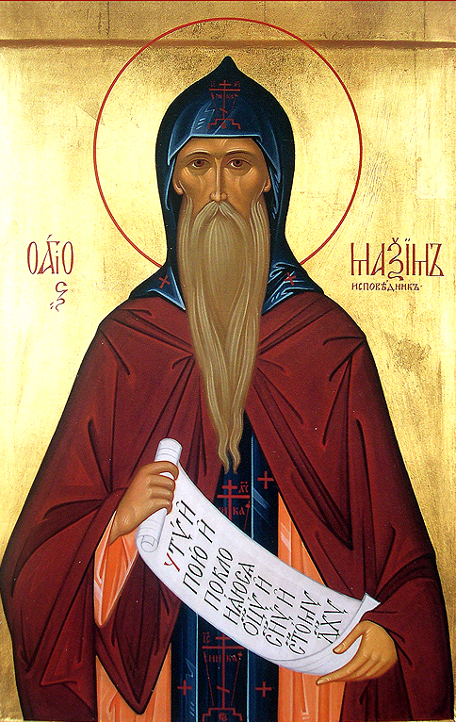
The Church Fathers’ Mystagogy
“initiation into the mystery of Christ”
“the baptized Christian regained ways of perception that has been lost to him or her in their fallen state; they acquired ‘spiritual senses’ This did not imply de-materialized senses, but senses that could grasp not just the superficial reality but the inner heart of things.”
“the symbolism [in the sacraments] was built up to replace the sense of loss in becoming a Christian [in apostolic times]”

Slide 9
“Official” Catholic Church Definitions
CCC 1075“Liturgical catechesis aims to initiate people into the mystery of Christ (it is ‘mystagogy’) by proceeding from the visible to the invisible, from the sign to the thing signified, from the ‘sacraments’ to the ‘mysteries.’”
OCIA 244 “The neophytes are introduced into a fuller and more effective understanding of the mysteries through the Gospel message they have learned and above all through their experience of the sacraments they have received.”

Slide 10

Updates on Language from RCIA to OCIA:
Greater emphasis on experience leading to understanding (lived encounter)
Communal Reality that the whole Church participates in
Intended to deepen grasp of the paschal mystery
Greater emphasis on integration into new Christian life

Slide 11
Sacramentum Caritatis (2007)
64. The Synod Fathers unanimously indicated, in this regard, a mystagogical approach to catechesis, which would lead the faithful to understand more deeply the mysteries being celebrated. (186) In particular, given the close relationship between the ars celebrandi and an actuosa participatio, it must first be said that "the best catechesis on the Eucharist is the Eucharist itself, celebrated well." (187) By its nature, the liturgy can be pedagogically effective in helping the faithful to enter more deeply into the mystery being celebrated. That is why, in the Church's most ancient tradition, the process of Christian formation always had an experiential character. While not neglecting a systematic understanding of the content of the faith, it centered on a vital and convincing encounter with Christ, as proclaimed by authentic witnesses. It is first and foremost the witness who introduces others to the mysteries.

Slide 12
Sacramentum Caritatis (2007)
a) It interprets the rites in the light of the events of our salvation, in accordance with the Church's living tradition. The celebration of the Eucharist, in its infinite richness, makes constant reference to salvation history...From the beginning, the Christian community has interpreted the events of Jesus' life, and the Paschal Mystery in particular, in relation to the entire history of the Old Testament.
b) A mystagogical catechesis must also be concerned with presenting the meaning of the signs contained in the rites. This is particularly important in a highly technological age like our own, which risks losing the ability to appreciate signs and symbols. More than simply conveying information, a mystagogical catechesis should be capable of making the faithful more sensitive to the language of signs and gestures which, together with the word, make up the rite.
c) Finally, a mystagogical catechesis must be concerned with bringing out the significance of the rites for the Christian life in all its dimensions – work and responsibility, thoughts and emotions, activity and repose…The aim of all Christian education, moreover, is to train the believer in an adult faith that can make him a "new creation", capable of bearing witness in his surroundings to the Christian hope that inspires him.

Slide 13
Take “OCIA” out of the equation for a minute–
“How have you encountered God this week?”
“How have you encountered Christ in the liturgy this week?”
Share with someone next to you!

Slide 14
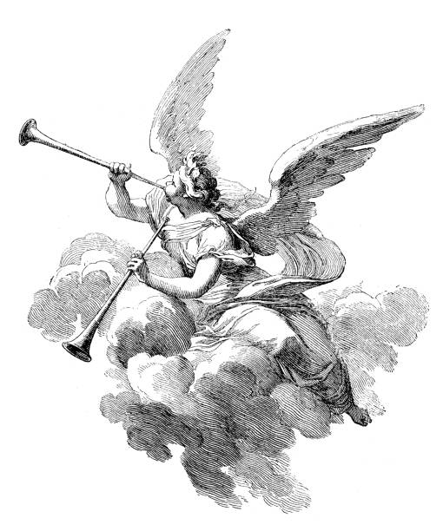
Mystagogy vs Evangelization: Distinct but Connected
Evangelization is the Church's core mission to proclaim Christ, invite conversion, and form disciples across all stages: missio ad gentes (to unbelievers), ordinary pastoral care, and re-evangelization of the lapsed
mystagogy assumes faith and sacraments, building on evangelization's fruits
The New Evangelization encompasses both: kerygma and catechetical deepening

Slide 15

Break

Slide 16
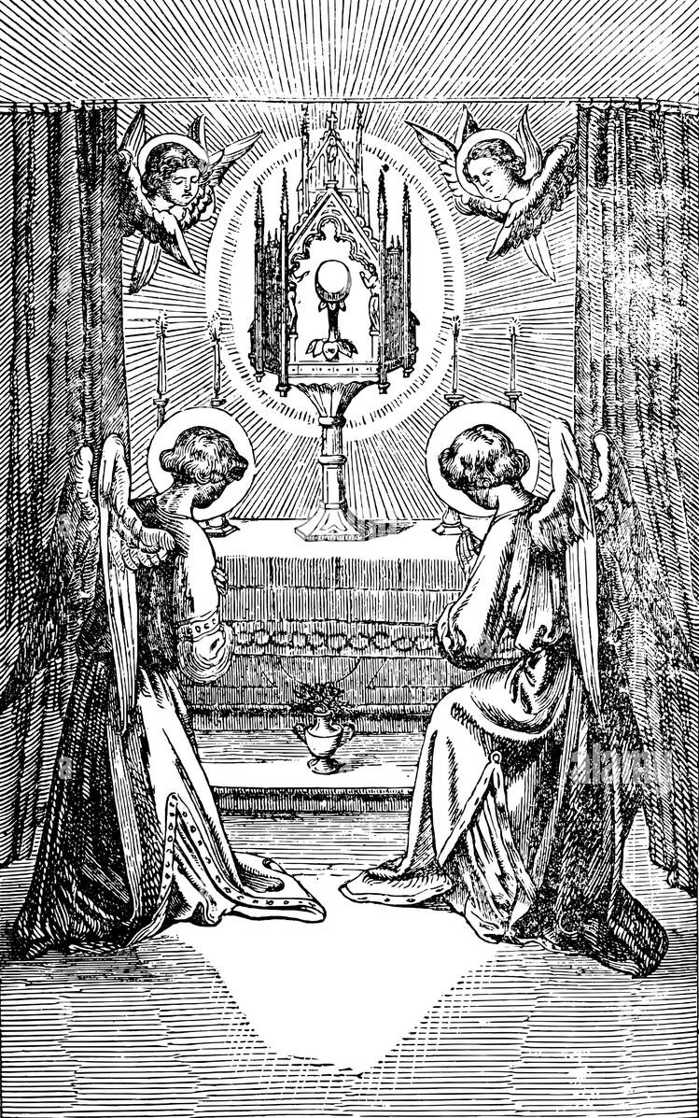
Table Discussions:
What surprised you about the Church’s words on mystagogy?
If you went to mass with a Catholic friend or family member you know doesn’t go every week, how would you ask them about their experience of receiving the Eucharist?

Slide 17
The Church’s Intended Design for Mystagogy
Primarily liturgical and experiential
provided through accompaniment (“witness”) of others farther along in the Christian journey
Does NOT have to be a weekly class– can be accomplished through participation in weekly mass and a few touchpoints in exploring their experiences

Slide 18
Table Brainstorming
Given the wide freedom here from the Church, what new ideas come to mind for a mystagogical experience for our newly baptized?
How can this be accomplished for our fallen away Catholics who have recently come back to Church?
How can this be accomplished for our kids/teens who are post-sacramental prep? What does it look like currently and what could it look like?

Slide 19


Coming this fall:
OCIA 101

Slide 20

Save the Date
Upcoming Workshops/Meetings/Events:
March 24/25- Archbishop Golka’s Installation
March 21/26- Baptism Gathering (pt 2)
May 7- OCIA Day of Reflection
May 14- YM Meeting: Teen Mental Health
Not Getting Our Newsletters? Sign Up Here!

