Slide 1

Risk Management Day
Alely Holguin-Risk Management Coordinator
Tom May-Chief Risk Officer
October 21, 2026

Slide 2

Come Holy Spirit, Devine Creator, true source of light and fountain of wisdom!
Pour forth your brilliance upon my dull intellect. Grant me a penetrating mind to understand, a retentive memory to learn, clarity of thought to comprehend, and abundant grace in expressing myself. Guide the beginning of my work, direct its progress, and bring it to successful completion. This I ask through Jesus Christ, true God and true man, living and reigning with You and the Father, forever and ever.
Amen

Slide 3
The Day’s Agenda
Time | Session | Discussion Focus
10:00-10:15 | Opening Prayer, Welcome, and Updated RM Manual | Set the stage for the day and introduce the updated Risk Management Manual.
10:15–10:45 | Introduction to Gallagher Bassett, Claims Reporting, General Q&A | Updated reporting process, required information, parish responsibilities, and Gallagher Bassett’s claims-administration role.
10:45–11:15 | Introduction to Lockton, Insurance Program Overview, Renewal Questionnaires, Email Communications and General Questions | Insurance program and entity deductibles overview, practical coverage, common questions, and lessons learned.
11:15-11:45 | Lockton Claims and Loss Control | Leading loss causes and loss control best practices
11:45–12:20 | Cyber Liability Program Changes and Required Security Controls | Coverage changes, required controls, compliance expectations, and the effect on coverage and deductibles.
12:20–12:30 | Break | Grab your lunch
12:30–1:00 | Working Lunch and Safe Environment Updates | Program updates, emerging issues, compliance expectations, and parish leadership responsibilities.
1:00–1:30 | Safety and Security Updates and Compliance | Current initiatives, compliance requirements, available resources, and expectations for parishes.
1:30–2:00 | Real Estate and Parish Asset Management | Asset management, deferred maintenance, property stewardship, capital planning, and other real estate topics.
2:00–2:15 | Break | Grab your caffeine
2:15–2:45 | School Compliance Topics and the Role of Business Managers | Coordination among parish and school leaders for inspections, AHERA, safety, facilities, and other compliance requirements.
2:45-3:00 | Meeting Recap and Adjourn | Thank You!!

Slide 4
What is the difference between Risk and Risk Management?

Slide 5
What is Risk?
  For a Catholic Archdiocese, risks are the factors (internal and external) that influence the Church's ability to carry out its Mission. They are not mission failures themselves, but the uncertainties and drivers, both positive and negative, that can affect pastoral effectiveness, financial stewardship, compliance, reputation, and long-term sustainability.

Slide 6
What is Risk Management?
  Risk management for the Archdiocese is about protecting the people, property, and resources entrusted to the Church so our Parishes, Schools, and other Ecclesiastical Entities (EEs) can carry out their mission. We help them identify risks, prevent harm, and respond when something goes wrong—through safety, insurance, claims support, and practical guidance. Our goal is to help leaders make informed decisions, safeguard the faithful, and be good stewards of the Church’s resources. It is not the role of one person or department, but the responsibility of all.

Slide 7
Parish Risk Management—Why it Matters
Risk Management is rooted in Stewardship and Prudence
Parables of the Faithful and Prudent Steward—Jesus’ teachings in Luke emphasize proactive oversight of entrusted resources, with accountability for negligence:
  Luke 12:42 – "Who then is the faithful and prudent manager whom his master will put in charge of his slaves, to give them their allowance of food at the proper time?“
  Luke 12:43-44 – "Blessed is that slave whom his master will find at work when he arrives. Truly I tell you, he will put that one in charge of all his possessions.“
  Luke 12:45-48 –"From everyone to whom much has been given, much will be required; and from the one to whom much has been entrusted, even more will be demanded.“
Risk affects everything we do.
  The typical Catholic parish is exposed to numerous risks daily.
  Unbudgeted losses detract from the parish mission.
  Adverse events can impact a parishes reputation and drive people away from the Catholic Church.
  Good risk management processes help ensure long-term sustainability and the smooth functioning of parish operation
Notes:
3 points: 1) Jesus taught the expectation of Stewardship and Prudence 2) He emphasized oversight of entrusted resources 3) He even called out accountability for negligence. I think we can all agree on the importance of Parish/Church RM.
So let’s start with some questions for the class. NEXT

Slide 8
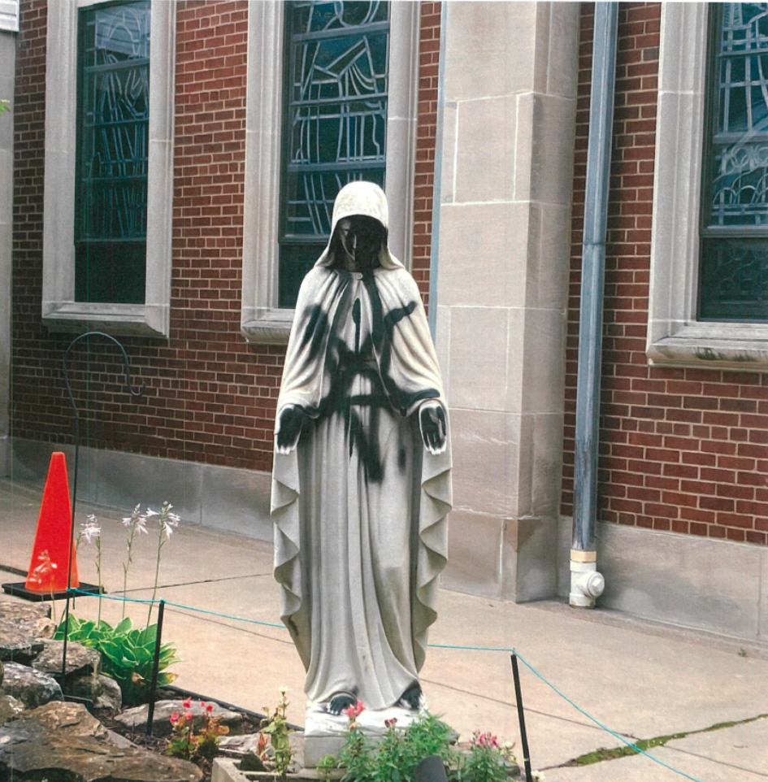
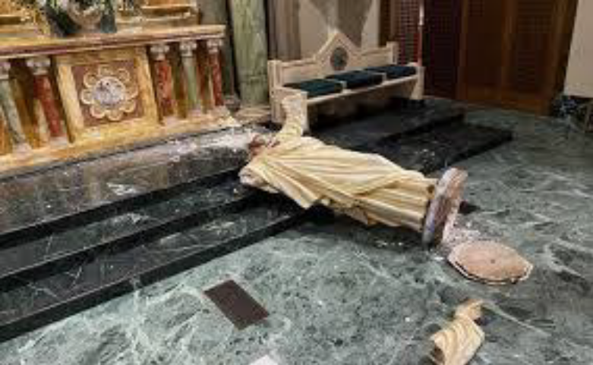
Parish Risk Management—How It Is Different in an Apostolic Age
The legal climate has created an entire class of litigation welfare. The Church is a key target.
It is not uncommon for parishioners and school families to sue their parish/school.
Employees can abuse the workers compensation system.
Our Parishes are targets for Cyber theft and security breaches which can cause significant financial and reputational harm.
Aging buildings are creating financial and moral hazards.
In Colorado (and other states) unfriendly legislatures are creating undue regulatory pressures for the Church.
Many parishes still feel the effects of the COVID shutdowns.
Geographic swings are impacting parish dynamics and financial wherewithal.
Notes:
Let’s discuss some of the realities facing the Church and why managing risk is different than it used to be.

Slide 9
Is Gallagher Bassett our Insurance Company, Third Party Administrator, or Insurance Broker?

Slide 10

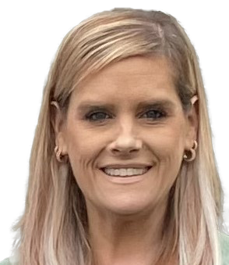
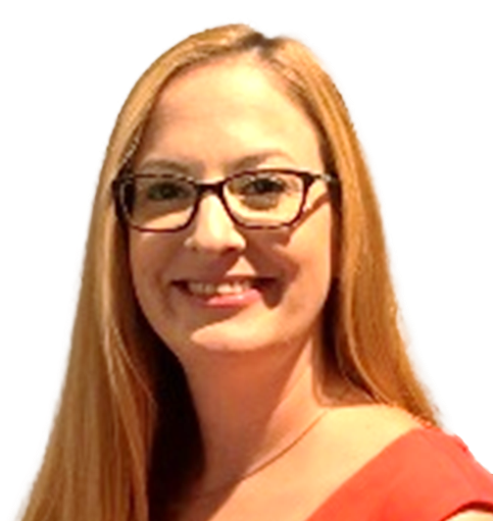

Archdiocese of Denver – Client Services Team
Karin Mahoney-Burke,
Director, Client Services
Direct & Mobile: 630-470-4840
Karin_MahoneyBurke@gbtpa.com
Michelle Sears,
VP – Client Services
Religious & Public Sector Leader
Direct & Mobile: 331-625-9274
Michelle_Sears@gbtpa.com
All rights reserved. ©
10
Notes:
Kick off with our own introductions

Slide 11

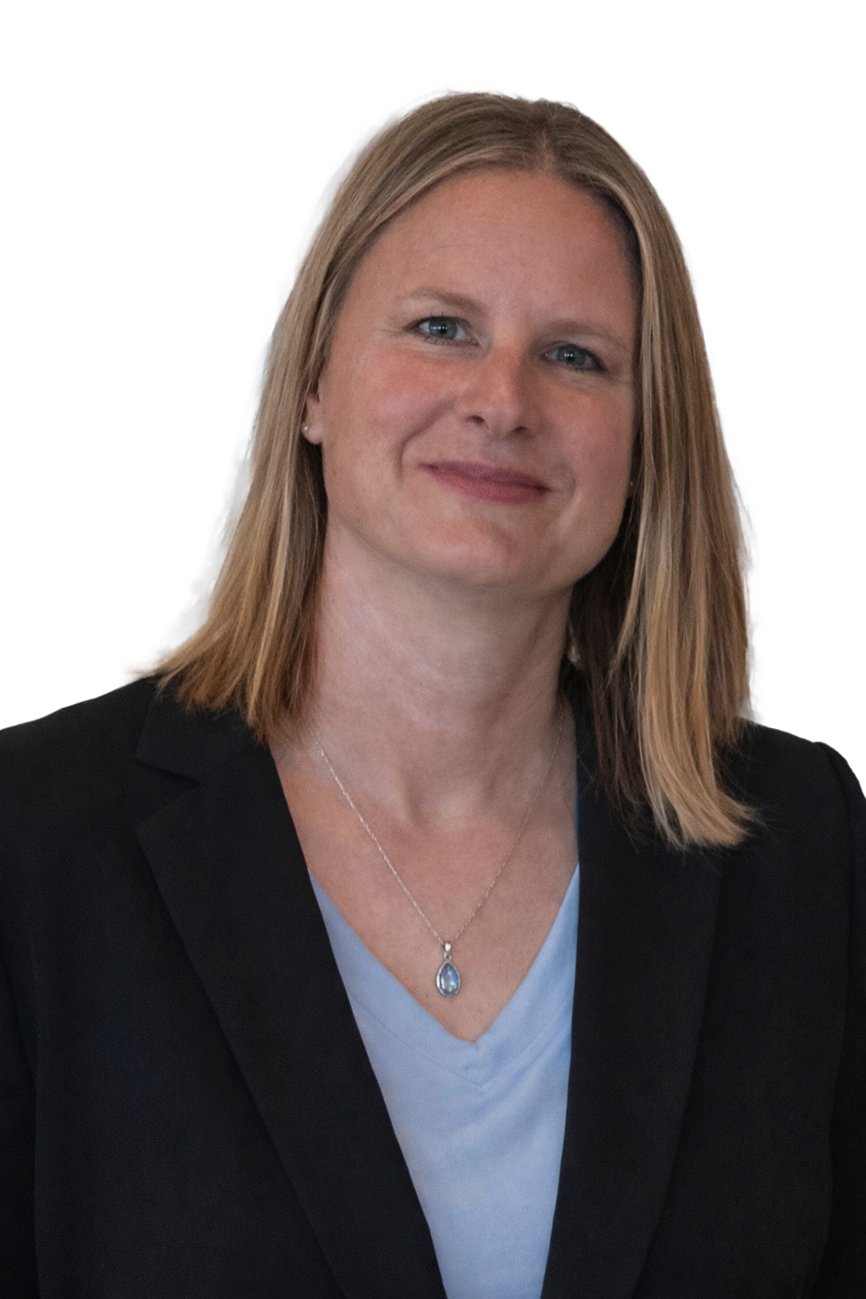

Archdiocese of Denver - GB Liability Team
Ron Rachlin
Vice President
Liability Practice
Non-SML
SML
Daisy Montano
Supervisor
daisy_montano@gbtpa.com
Chris Spala
Supervisor
christopher_spala@gbtpa.com
Matthew Gibbs
Lead Resolution Manager
matthew_gibbs@gbtpa.com
Corina West
Senior Resolution Manager
corina_west@gbtpa.com
Jennifer Rajzer
Assistant Branch Manager
Religious & Public Sector Practice
Megan Benedict
Senior Resolution Manager
megan_benedict@gbtpa.com
Bryan Reinard
Senior Resolution Manager
bryan_reinard@gbtpa.com
All rights reserved. ©
11

Slide 12

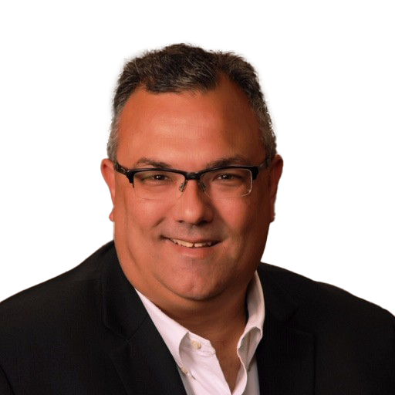
Archdiocese of Denver - GB Property Team
John Danielson
Assistant Branch Manager
Property Practice
Melissa Nederhoff
Supervisor
melissa_Nederhoff@gbtpa.com
Brad McHam
Senior Resolution Manager
brad_mcham@gbtpa.com
Phil Coello
Senior Resolution Manager
phil_ceollo@gbtpa.com
All rights reserved. ©
12

Slide 13
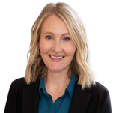

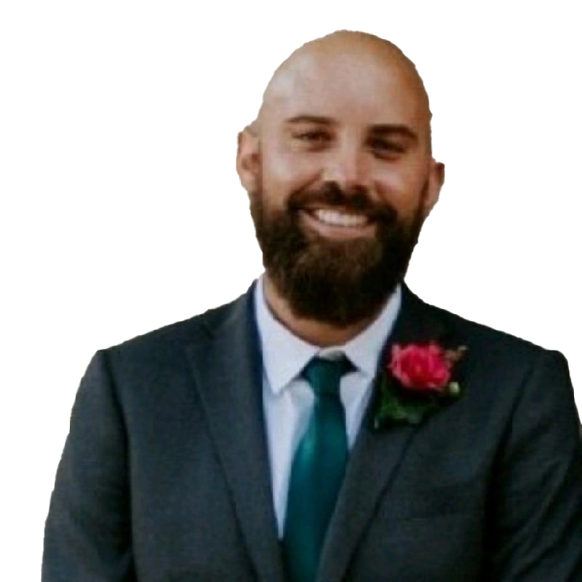

Archdiocese of Denver - GB WC Team
Medical Only
Indemnity
Debora Bredl
Supervisor
debora_bredl@gbtpa.com
Kimberly Schmitt
Supervisor
kimberly_schmitt@gbtpa.com
Barbara Sanders
Medical Only Representative
barbara_sanders@gbtpa.com
Shirley Smith
Senior Resolution Manager
shirley_smith@gbtpa.com
All rights reserved. ©
13

Slide 14

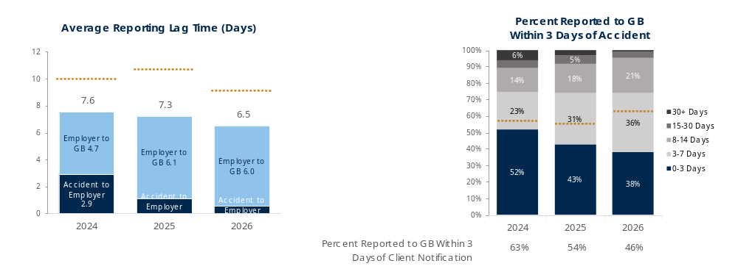
WC Claim Reporting Lag
Benchmark is for % reported in 0-3 days
While the average reporting lag time outperforms the benchmark, the percentage of claims reported within 0-3 days continues to decrease year-over year and is under the benchmark.
The main lag driver is employer to GB lag.
Includes LT and MO claims. Excludes no cost claims and voided claims. Reporting lag capped at 90 days.
Notes:
Next slide – Dig deeper by Division

Slide 15
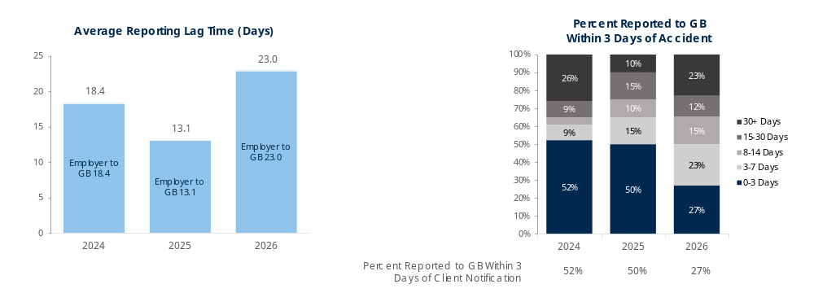
Property Claim Reporting Lag
Benchmark is for % reported in 0-3 days
The average property lag went up approximately 10 days in 2026, and the number of claims reported within 0-3 days went down 23%.
Includes BI and PD claims. Excludes no cost claims and voided claims. Reporting lag capped at 90 days.
Notes:
By Ministry is next.

Slide 16
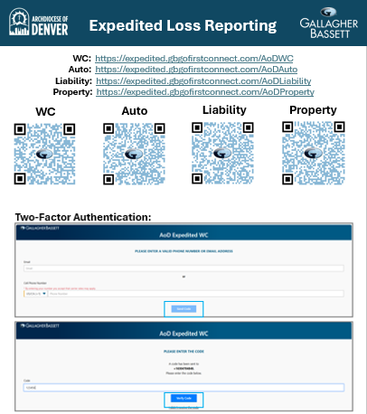
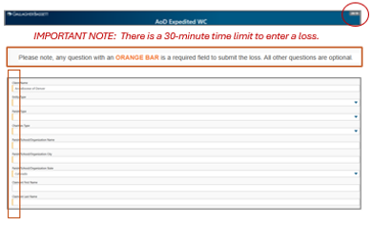
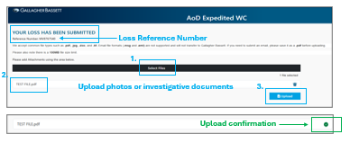
Expedited Loss Reporting
Notes:
Carrie

Slide 17
GB Standards of Excellence
What We Believe
Who We Are
How We Operate
1
Gallagher Bassett helps people and companies prevent, manage, and overcome the impact of risk.
8
We are professionals. We take pride in our work and how we are perceived.
12
Excellence begins during the sales process.
13
Client expectations must be understood, documented, communicated, and reinforced.
9
We are experts. We confidently share our knowledge, experience, and insights with others.
2
We are the very best at what we do. We are on a mission to grow and serve as much of the market as possible/practical.
Timely and effective communication is the cornerstone of excellence in our business.
14
We are problem solvers. We exhaust every effort to come up with solutions to challenges we, and those we serve, encounter.
15
We bring energy and enthusiasm to every interaction with clients, injured workers, and claimants.
3
We are privileged to serve every client, injured worker, and claimant we encounter.
10
16
We are proactive and aggressive in driving resolution on client and claim matters.
4
We are an integral partner of our clients; we contribute meaningfully to their business success.
11
We are innovators. We are in continuous pursuit of a better way in everything we do.
We thoroughly document our work to ensure it withstands internal and external scrutiny.
17
Every person and every function at Gallagher Bassett has a customer, either internal or external.
18
We relentlessly measure and drive exceptional performance across our teams.
5
19
We deliver demonstrably superior outcomes to every client we serve.
6
We are entitled to dignity and respect from everyone we interact with (internally and externally).
20
We actively share insights, best practices,
and processes across our business to benefit
all clients.
7
Delivering financial excellence for Gallagher Bassett is an enabler, not a barrier, to excellence.
21
We hold ourselves to the highest professional standards (i.e., ethics, regulatory, legal).
Notes:
Carrie

Slide 18
Lockton is our Insurance Carrier and determines the cost of our insurance premiums. T or F? Why?

Slide 19
Introduction to lockton

Slide 20
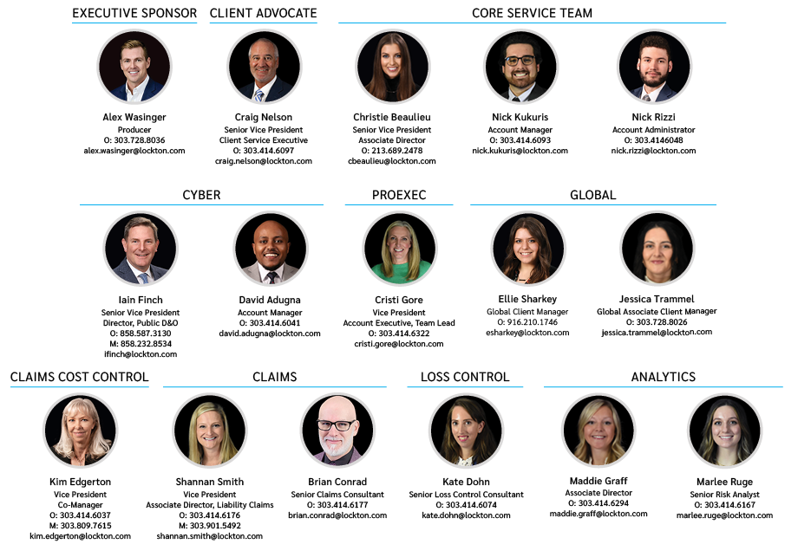
Introduction to Lockton
AoD
Lockton
Carrier
Who is Lockton?
Lockton (Broker) vs. Carrier (Insurer)
Lockton is AoD’s risk and insurance advisor.
Lockton represents AoD, not the insurance carriers.
We help design insurance strategies that align with AoD’s business and risk management objectives.
We negotiate coverage, pricing, and terms with insurers.
We provide market intelligence, claims support, and risk management guidance.
Our role is to advocate for your interests before, during, and after policy placement.
Lockton is your advisor and advocate. Your Carrier is the
financial institution that ultimately takes on and funds the risk.
Lockton (Broker) | Carrier (Insurer)
Represents your company | Provides insurance coverage
Markets your program to insurers | Assumes the financial risk
Negotiates pricing and terms | Underwrites and prices the risk
Advises on strategy and coverage | Issues policies
Advocates on claims and service issues | Pays covered claims
Provides ongoing account support | Provides policy and claims administration

Slide 21
Lockton
Service
Team
Notes:
An introduction to Lockton, the broker’s role, and a team chart showing who supports our account. Please clarify the distinction between Lockton’s role and that of our insurers, as this remains a source of confusion.

Slide 22
Insurance program overview

Slide 23
*Deductibles/SIRs represent policy retentions not entity deductibles.
 | $1,000,000,000 Limit | $150,000,000 Limit |  | $250,000,000 Limit
 | AXA XL (Lead Carrier) $1,000,000,000 x $2,000,000 Various sublimits | Lloyds - Talbot Terrorism & Sabotage (Property & Liability) $150,000,000 Property limit $20,000,000 Liability limit |  | Travelers B&M $250,000,000 per breakdown
 |  |  |  |  |  | $40,000,000 Limit
 |  |  |  |  |  | Ironshore $5,000,000 x $35,000,000
 |  |  |  |  |  | Lexington $5,000,000 x $30,000,000
 |  |  |  |  |  | Aurenity/Vantage $5,000,000 x $25,000,000
 |  |  |  |  |  | Sutton Specialty Insurance Company $5,000,000 x $20,000,000
 |  |  |  |  |  | Gemini Insurance Company $5,000,000 x $15,000,000
 |  |  |  |  |  | Fortegra Specialty Insurance Company $4,000,000 x $11,000,000
 |  |  | Lloyds - Samphire Active Assailant/ Malicious Attack $10,000,000 per occurrence/aggregate |  | Old Republic Union $5,000,000 x $6,000,000 Policy #: 822600 1257468
 |  |  |  |  | Munich Re/PESLIC $5,000,000 x $1,000,000
 | Bishops' Plan Trust (BPIC) $2,000,000 |  |  |  | Bishops' Plan Trust (BPIC) SML $750,000 xs $250,000 | Bishops' Plan Trust (BPIC) GL $750,000 xs $250,000 | Bishops' Plan Trust (BPIC) Misc. Liability Employment Practices Sexual Harassment Errors & Omissions D+O $750,000 xs $250,000 | Bishops' Plan Trust (BPIC) Auto Liability $750,000 xs $250,000 | AIG Foreign Package $1,000,000 | Zurich Excess Employers' Liability $750,000 xs $250,000 | Zurich Employers' Liability $1,000,000 each accident $1,000,000 policy limit $1,000,000 each employee
SIR / Deductible | $500,000 SIR | NIL | NIL | $50,000 Deductible | $250,000 SIR | $250,000 SIR | $250,000 SIR | $250,000 SIR TOTAL Trust SIR: $150,000 Zurich: $100k Limit/$100k Ded | Liability - NIL Auto Phys. Dam - $1,000 Deductible | $250,000 SIR | NIL
Coverage | Property & Auto Physical Damage | Terrorism & Sabotage | Active Assailant | Boiler & Machinery | Sexual Abuse & Molestation | General Liability | Miscellaneous Liability | Auto Liability | Foreign | Excess Employer's Liability (CO) | Excess Employer's Liability (AOS)
Notes:
A brief overview of the insurance program using the program schematic.

Slide 24
*Deductibles/SIRs represent policy retentions not entity deductibles.
Zurich Workers Compensation (CO) Statutory Limits xs $250,000 SIR | Zurich Workers' Compensation - Guaranteed Cost (AOS) Statutory Limits
 |  |  |  |  |  | XL Specialty Insurance Co. Fine Arts $5,000,000 blanket limit | Beazley Premises Environmental Liability $1,000,000 per occurrence $5,000,000 aggregate | Resilience Cyber $5,000,000 limit
 |  | Atlantic Specialty Employed Lawyers Liability $1,000,000 limit | Everest Student-Volunteer Accident $1,000,000 per accident | AIG Business Travel Accident $1,000,000 per accident Various sublimits |  |  |  |  | Travelers Fiduciary $1,000,000 limit | Travelers Crime Employee Theft: $1,000,000 limit Various sublimits | TMHCC Special Crime $1,000,000 limit Various sublimits
$250,000 SIR | NIL | $25,000 SIR | NIL | NIL |  | $5,000 AOP Deductible $5,000 Vandalism Deductible | $24,000 Deductible | $75,000 SIR | $10,000 SIR | $25,000 SIR | NIL
Excess Workers' Compensation (CO) | Workers' Compensation (AOS) | Employed Lawyers Liability | Student-Volunteer Accident | Business Travel Accident |  | Fine Arts | Premises Environmental Liability | Cyber | Fiduciary Liability | Crime | Special Crime
Notes:
A brief overview of the insurance program using the program schematic.

Slide 25
Self-Insured Retentions and Entity Deductibles as of 7/1/2026
Line of Coverage | Deductible paid by Covered Entity FY2027 | Policy Self-Insured Retention/Deductible
Auto Collision | $5,000 | $500,000
Auto Liability | $5,000 | $250,000
Boiler & Machinery | $5,000 | $50,000
Crime | $25,000 | $25,000
Cyber | $0(1), $10K(2), $10K(3), $75K(4) | $75,000
Liability (EPL, 3Rd Party, SML, etc.) | $5,000 | $250,000
Property | $5,000AOP and WH 3% off loss once claim exceeds $1M | $500,000/WH 3% of TIV
Environmental | $24,000 | $24,000
Workers Compensation | $5,000 (not collected in prior years) | $250,000
Priests Personal Property | $500 | SI up to $50,000
Fine Arts | $5,000 all losses | $5,000

Slide 26
RENEWAL QUESTIONNAIRES

Slide 27
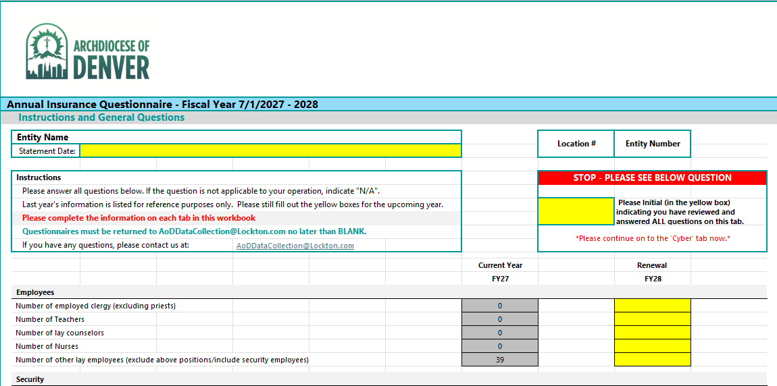
Renewal Questionnaire Timeline
Mid-February to Early March
Update property values per Kroll appraisal file
Create entity specific questionnaires
Send final questionnaires to all entities
Lockton to conduct and record a virtual Q&A meeting for all business managers
Lockton to send weekly reminders to all entities to complete questionnaires
Receive completed questionnaires back from entities
Mid-March
Review questionnaires and work through questions
Consolidate all questionnaires into one SOV for submission to markets
Review final SOV with AoD Risk Management team before sending to markets
Notes:
An explanation from Nick and Nick of the renewal questionnaires, why they matter, and the importance of complete and accurate responses.
The email addresses available for communication and when to use each.

Slide 28
Questionnaire and AoD Email Inbox
Accurate renewal data starts with the right information sent to the right inbox.
Questionnaires
Accuracy matters
  The information submitted is reported to carriers and directly impacts renewal premiums.
Complete every field
  Missing information makes it difficult to provide carriers with an accurate submission.
Review before submitting
  Confirm entity details, exposures and values are complete ad current
Join the Q&A session
  We will review the questionnaire and highlight changes for this renewal cycle
Use the Correct Inbox
Project-Based Inbox
AoDDataCollection@Lockton.com
  Use for: Questionnaires, allocation, and winterization projects
  Not monitored throughout the policy term
Ongoing Inbox
ArchdioceseofDenver@Lockton.com
  Use for: Insurance questions, exposure updates and MVR monitoring
  Monitored throughout the policy term
Notes:
An explanation from Nick and Nick of the renewal questionnaires, why they matter, and the importance of complete and accurate responses.
The email addresses available for communication and when to use each.
Please include any other key points you believe would be helpful and leave time for Q&A.

Slide 29
Q & A
Thank you!

Slide 30
Loss Control & Prevention Overview
October 21, 2026
Kate Dohn-Loss Control Consultant
Lockton
Shannan Smith- Associate Director- Claims
Lockton

Slide 31
What Is Loss Prevention?
Having systems, programs, policies and procedures in place to prevent a loss from occurring
Preventing visitor, member, contractor injuries
Preventing employee injuries
Preventing property damage and losses
Preventing auto accidents and damage

Slide 32
Achieving Loss Prevention Goals
Written policies and procedures
Employee health and safety programs
Motor vehicle and driving policies
Emergency action plans (EAPs)
Alcohol and drug free workplace policies
Workplace violence policies
Facility inspection checklists and safety
Preventative maintenance programs
Daily, weekly, monthly, quarterly, annual inspections
Winterization preparation
Provide training and education
Boiler Inspections and corrections

Slide 33
What is Loss Control?
  Reducing the severity of an incident/claim when they occur
    Locating water shutoff valves
    Providing medical care as soon as possible
    Contacting and checking in on injured person
    Fixing identified hazard immediately

Slide 34
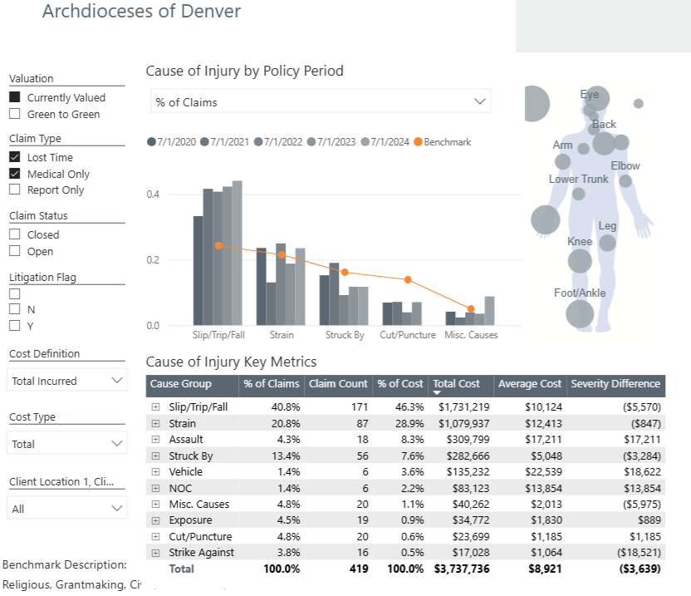

Slide 35
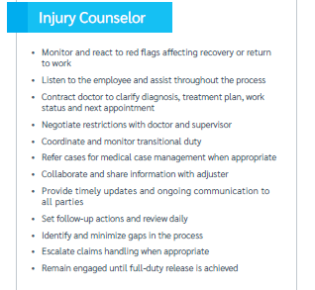
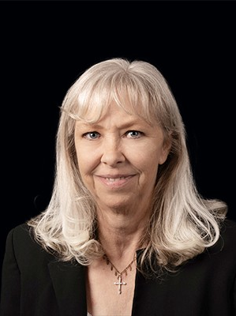
Injury Counselor
Kim Edgerton
AoDInjuryCounselor@lockton.com
303.809.7615

Slide 36
 | Claim Count | Average Incurred | Total Incurred
General Liability | 191 | $8,849.44 | $1,690,243.67
2021-2022 | 28 | $1,673.02 | $46,844.64
2022-2023 | 46 | $18,421.77 | $847,401.23
2023-2024 | 40 | $6,436.04 | $257,441.40
2024-2025 | 33 | $9,282.04 | $306,307.34
2025-2026 | 44 | $5,278.39 | $232,249.06
Property | 304 | $36,087.52 | $10,970,607.50
2021-2022 | 56 | $8,687.48 | $486,498.80
2022-2023 | 92 | $49,740.26 | $4,576,103.53
2023-2024 | 64 | $54,002.90 | $3,456,185.77
2024-2025 | 40 | $25,871.19 | $1,034,847.72
2025-2026 | 52 | $27,249.46 | $1,416,971.68
*as of 8/21/2026
Notes:
2022-2023 GL Claim
$283,684 assaulted in front of building multiple broken bones
$181,000 discrimination
$159,154.50 slip and fall on ice broken bones
3 claims make up 74% of the costs
2023-2024
$136,000 EPL wrongful termination of contract
$59,814.50 EEOC Compliant
$38,207 Discrimination
3 claim make up 91% of the costs
2024-2025
$140,000 trip and fall
$120,000 trip and fall on vacuum cord
2 claims make up 85% of the costs
2025-2026
$55,000 discrimination
$50,000 discrimination
$40,000 discrimination
$28,000 discrimination
4 claims make up $75 of the costs
Property
2021-2022
$113,085 hail damage
$89,083 robbery
2 claims make up $42% of the cost
2022-2023- hail damage
$1,525,794 hail damage
$491,447 hail damage
$305,275.16 broken pipe
$218,877 fire
$215,441.18 hail
$175,809.65 hail
2023-2024
$605,200 hail damage
$582,438 Hail damage
$446,152.29 hail storm
$353,190.09 Hail
$265,000 hail
2024-2025
$340,000 fire
$278,049- fire sprinkler line broke and flood
$149,410 meth cleanup
$84,972- boiler failure
2025-2026
$510,000 hail damage
$360,000 hail damage
$169,000 hail damage
$52,804 hail damage

Slide 37
Coverage/Policy Year | Claim Count | Average Incurred | Incurred Total
Workers Compensation | 871 | $7,995.78 | $6,964,324.15
2017-2018 | 102 | $10,993.36 | $1,121,322.97
2018-2019 | 103 | $6,940.87 | $714,909.10
2019-2020 | 91 | $8,198.09 | $746,026.32
2020-2021 | 80 | $8,419.53 | $673,562.07
2021-2022 | 100 | $7,721.66 | $772,165.62
2022-2023 | 92 | $5,914.19 | $544,105.73
2023-2024 | 97 | $7,850.77 | $761,524.68
2024-2025 | 111 | $9,993.38 | $1,109,265.22
2025-2026 | 95 | $5,488.87 | $521,442.44
Grand Total | 871 | $7,995.78 | $6,964,324.15
*as of 8/21/2026
Notes:
2017-2018
$408,164 slip/trip/fall
2019-2020
$208,521 Struck by
2021-2022
$212,094 slip,/trip/fall ice
2022-2023
$227,805.01 Workplace violence
2024-2025
$203,649 Slip/trip/fall
$106,133 pushing object

Slide 38
Worker’s Compensation Claim Scenario
  Employee is cleaning out gutters while standing on a ladder, falling 8 feet to the ground, breaking arm, fracturing 3 ribs and is transported to the hospital via ambulance
    Misses 12 weeks of work due to surgery and broken bone recovery
    On light duty for 6 additional weeks
    Back to work, released from care 25 weeks after injury
    Medical costs: $35,543
    Indemnity costs: $48,435
    Total Incurred: $83,978
  Should this employee have been cleaning gutters on a ladder?
    How was the ladder set up?
    Training on ladder safety?
    Condition of ladder?

Slide 39
Property Damage Claim Scenario
  Cold snowstorm hits producing 16 inches of snow and cutting power to church for 15 hours. The interior temperature dips below 40 degrees and a pipe burst, spilling water into the church for 24 hours before it is discovered.
    Damage to carpet, walls, pews, AV equipment and piano valued at $146,539.25
    Water remediation, demolition and rebuild costs $36,125.32
    Loss of use for 60 days until rebuild is completed
    Renting local space to host church events and serves: $3,231.12
    Total costs: $185,895.69
  Winterization preparation?
    Monitoring building temperatures
    Accessing building during big winter events
    Remote monitoring

Slide 40
General Liability Claim Scenario
  A HVAC vendor is working on a broken AC unit and falls in the parking lot from stepping into an 18 inch wide x 3 inch deep pothole. Vendor sustains broken elbow and concussion from fall.
    Medical expenses: $32,987.15
    Attorney fees: $23,285.59
    Total Cost: $56,272.74
  Preventative Maintenance Program?
    Was this pothole known by staff at this location?
    When was the last inspection conducted?
    Was this pothole identified during the inspections?
    Why wasn’t it fixed, patched/labeled to prevent injury?

Slide 41
Kate Dohn kate.dohn@lockton.com
Questions?
Shannan Smith
Shannan.smith@lockton.com

Slide 42
Which of the following is NOT one of the four cyber security controls required by our carrier, Resilience?
MFA
EDR
Barracuda Firewall
Offline Immutable Backups

Slide 43

Cyber Liability and Security Update
Mike Lafond – IT Director AoD
Ed Brandorff-Consultant AoD
Ariel Brown-Resillience
Sevan Sarkhoshian-Resillience

Slide 44
Cyber Liability Renewal Update
  The policy renewed on 7/1/2026
    Premiums increased 152% to $174,524 from $69,127
    Policy aggregate remained at $5M but limited based on coverage category
    Policy sublimits also reduced according to coverage category
  Coverage summary categories 1-4
    Category I — all four controls present
      Per-member aggregate: Full pool limit and $0 deductible
      Extortion event sublimit: Full
      eCrime / Social Engineering sublimit: $100,000
    Category II — three of four controls (with MFA for remote access in place)
      Per-member aggregate: $2,000,000 and $10,000 deductible
      Extortion event sublimit: $500,000
      eCrime / Social Engineering sublimit: $100,000
    Category III — two of four controls (with MFA for remote access in place)
      Per-member aggregate: $1,000,000 and $10,000 deductible
      Extortion event sublimit: $250,000
      eCrime / Social Engineering sublimit: $100,000
    Category IV — one or zero controls, OR fails MFA for remote access (hard floor)
      Per-member aggregate: $1,000,000 and $75,000 deductible
      Extortion event sublimit: $100,000
      eCrime / Social Engineering sublimit: $100,000

Slide 45
Cyber Security Coverage
Coverage Category Summary (7/1/2026 Renewal)
Coverage Category | Per-Member Limit | Members | Extortion Event Sublimit | eCrime / Social Eng. Sublimit | Qualifying Controls | Retention
Category 1 | Full | 59 | Full | $250,000 | All 4 critical controls | $0
Category 2 | $2,000,000 | 18 | $500,000 | $100,000 | 3 of 4 (incl. MFA remote) | $10,000
Category 3 | $1,000,000 | 31 | $250,000 | $100,000 | 2 of 4 (incl. MFA remote) | $10,000
Category 4 | $1,000,000 | 77 | $100,000 | $100,000 | 1/0 controls, no MFA remote, non-responsive, or pending | $75,000
TOTAL |  | 185

Slide 46
Cyber Risk Discussion
Archdiocese of Denver business manager meeting
10/21/2026
Ariel Brown, Customer Success Lead, Resilience
Sevan Sarkhoshian, Director, Security and Risk Services, Resilience

Slide 47
Agenda
1
The threat landscape
What is happening in cyber risk, and what our claims and threat intelligence show
What it means for you
2
How each coverage group is exposed to current threats
Parish scenario
3
What would a cyber attack look like without these controls

Slide 48
What is happening in cyber risk
1
2
3
Human Error: The #1 Driver of Loss
Ransomware: Rare but Disproportionately Costly
Disclosure to exploit: -7 days
85.3% of incurred losses came from phishing, social engineering, or transfer fraud — up from 17.7% in H1 2024.
73% of incurred losses came from ransomware extortion, despite it representing only 5.8% of total claims.
The exploit arrives about a week before the patch. 42% of the exploited flaws are hit before public disclosure.

Slide 49
What each control protects against
Control | Risk it addresses | What we are seeing
MFA | An additional layer of protection that secures accounts even if a password is exposed. | In 2025, there were 3.3B stolen credentials found on criminal markets with an estimated 48 hour theft to extortion time period.
EDR | Actively detects and prevents malicious activity on a computer. | It takes an average of 29 minutes for threat actors to move laterally to other systems.
Offline or Immutable backups | Protects against modification or deletion of backup. | Shift in ransomware landscape where threat actors are starting to conduct extortion only attacks.
Email Security | Prevents the delivery of malicious links used in social engineering attacks. | The primary way that credentials are stolen is through social engineering attacks.
Key takeaway: Defense in depth. All these controls are meant to work together to prevent and mitigate impacts of a cyber incident at different stages of an attack chain.

Slide 50
When the controls fail: a parish scenario
Email security
A fake email reaches the administrator's inbox. She clicks the link and enters her password on a look-alike login page. The attacker captures it.
MFA
No second check, so the stolen password is enough. The attacker logs in and expands their access. Theft to extortion can take as little as 48 hours.
EDR
Nothing detects them. In about 29 minutes they reach the finance PC and shared drive and copy donor and sacramental records.
Offline or immutable backups
Always-connected backups are deleted. Nothing to restore, so the attacker demands payment or leaks the data.
Key takeaway: One stolen password plus one missing control became a full breach. Any control working as intended breaks the chain.

Slide 51
Cyber Control Rollout & Attestation Process
Michael Lafond
Director of Information Technology
Michael.Lafond@archden.org
(303) 715-3201
Ed Brandorff
Consultant
Ed.Brandorff@archden.org

Slide 52
Rollout – Data Collection
Multiple Surveys
  Insurance Renewal Questionnaire
    Resilience requested four cyber controls
  Lockton follow-ups
    Do you have these controls in place
    How many endpoints
  Cybersecurity Survey
  Final Attestation
Questions may be directed to: cybersecurity@archden.org

Slide 53
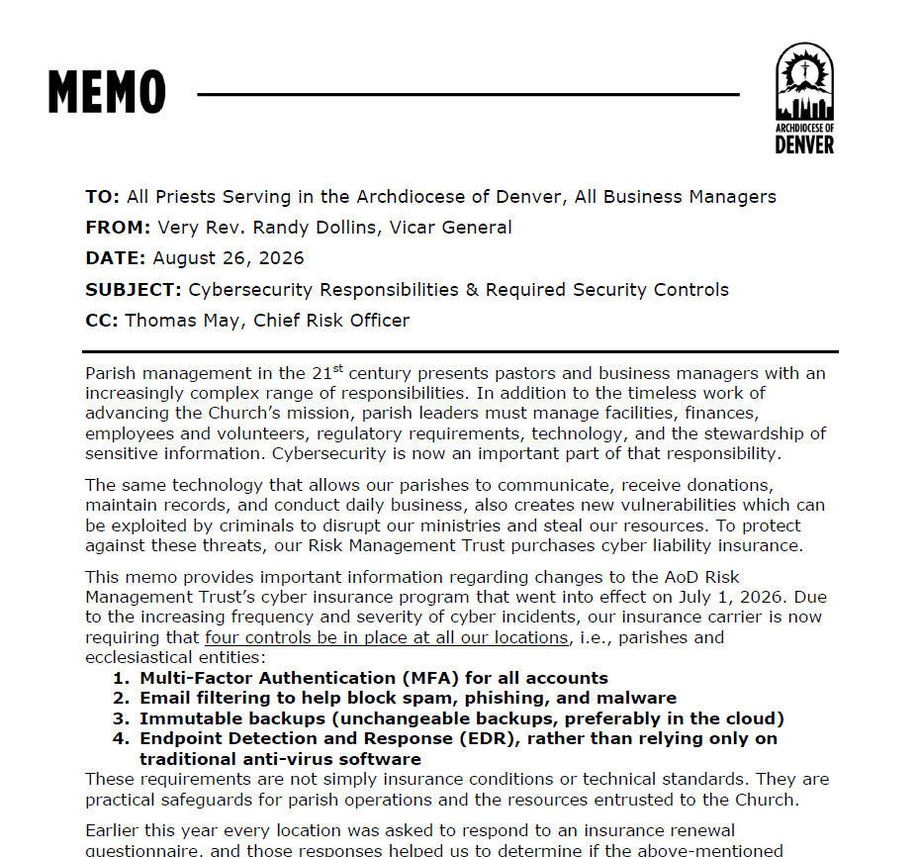
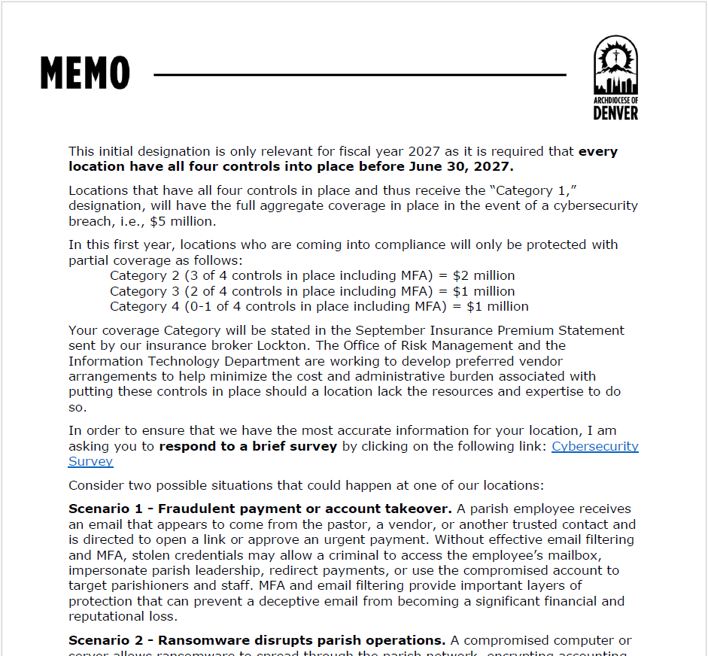
Rollout – Vicar General’s Memo

Slide 54

Rollout – Process
Cybersecurity Survey
  Link in email or you can use this link: https://tinyurl.com/AOD-Cyber
  Asks for products in use to verify compliance
  Ed will review answers to certify compliance level
    Some products in use may not qualify
Final Attestation
  After all controls in place, please complete and email to: cybersecurity@archden.org

Slide 55
Product Recommendations
Recommended product stack:
  Tell them you are with the Archdiocese of Denver!
Requirement | Recommended Solution
MFA | Microsoft or Google
EDR | Sophos MDR (https://www.sophos.com) Sales Rep: Sam Heard (https://disrv.com) Email: samh@disrv.com Phone: 863-683-5845
Email Filtering | Sophos Email (https://www.sophos.com) Sales Rep: Sam Heard (https://disrv.com) Email: samh@disrv.com Phone: 863-683-5845
Immutable Backups | Cloudally (https://cybersecurity.opentext.com/legacy/cloudally) Sales Rep: Josh Perry (https://constantedge.com) Email: josh.perry@constantedge.com Phone: (302) 485-0195

Slide 56
Product Recommendations
Recommended product stack:
  Benefits:
    Pricing
      May be as low as $75/endpoint/year w/2-year contract - If we have enough parishes opt-in
    Works with both Microsoft and Google
    Dashboard
Need help installing?
  Ed is available for a fee
  Other vendors can be recommended as well

Slide 57
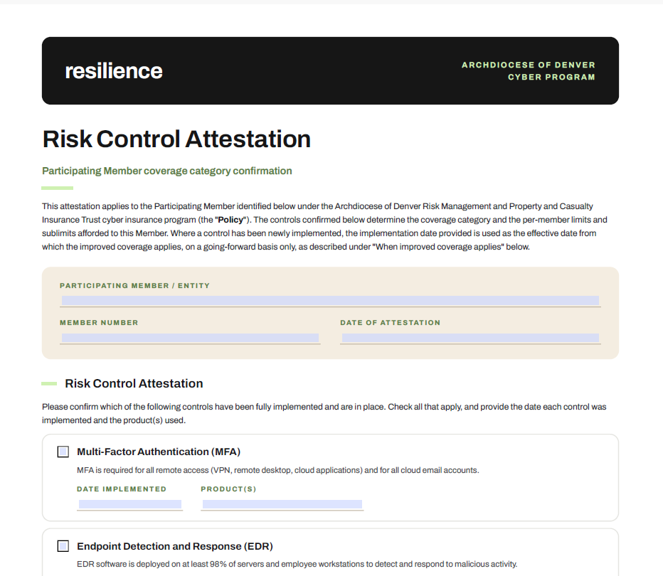
Raising Status
Once compliant products installed:
  Complete and email Attestation form to: cybersecurity@archden.org
  Products will be verified
  Forms will be forwarded to Lockton
  Resilience will upgrade your status / tier
  Increased coverage will take effect
Notes:
Discuss why there were multiple surveys – Initial insurance questionnaire, then Lockton following up to ask for endpoints, finally survey in letter from Fr. Dollins

Slide 58
Questions?
Michael Lafond
Director of Information Technology
Michael.Lafond@archden.org
(303) 715-3201
Ed Brandorff
Consultant
Ed.Brandorff@archden.org

Slide 59
Break and grab your lunch

Slide 60
What is one of the two upcoming changes to the background-check processes or administration that business managers should watch for and be prepared to act on?

Slide 61
Safe Environment
Our Shared Mission of Protection and Care
Alex Kwan
Program Manager
Office of Minor and At-Risk Adult Protection

Slide 62
One Mission, Shared Responsibility
Safety is an expression of our Mission
♡
Distinct responsibilities. One shared purpose
Care for the vulnerable
Prevent harm
Respond with compassion
Support healing and restore trust
SAFE ENVIRONMENT
✓
RISK MANAGEMENT
○
SAFETY & SECURITY
✧
We are called to create a Church where every person is treated with dignity
and can participate in a community of safety and trust.

Slide 63
Our Systems Should Serve People
Compliance helps ensure people are prepared and safeguards are in place
Impacts employees, volunteers, activities, events, and spaces - even those not directly associated with the parish/school all matter
Safe Environment, Risk Management, and Safety & Security are working to improve coordination
Alely Holguin, Risk Management Coordinator, serves as a liaison with Safe Environment
Goal: clearer guidance and more streamlined tracking and processes and documentation of such

Slide 64
Your Partnership is Critical
Oversight of everyday operations
Leader in creating a culture of safety
Key touchpoint for changes in policies and processes
Coordination with the Safe Environment Coordinator
Partnership with the pastor to communicate and live out our mission

Slide 65
A Safe Environment is Revealed by How We Respond
When a concern is raised:
Do church workers know about their responsibilities to respond?
Do people know how and where to report concerns?
Can concerns be raised and taken seriously—even when uncomfortable?
Do we respond with compassion, appropriate reporting, and confidentiality?
Are there supports at the location to support the person making the report?
Concerns should be directed appropriately, not informally investigated or left unresolved
The business manage can help create an environment where concerns can be raised and directed appropriately, rather than overlooked, informally handled, or left unresolved.

Slide 66
A Safe Environment is Revealed by How We Respond
How we support you:
Reporting Posters and handout
Clearer guidance on reporting steps and documentation
Support from the Victim Assistance Coordinator and Safe Environment Program Manager
Working together to support you!

Slide 67
Food for thought…
If someone came to your parish or school tomorrow with a concern about the safety of a child or vulnerable adult, would the all the employees and/or volunteers involved know what to do, who to contact, and how to respond?
What are the risks or consequences if not?

Slide 68
Protecting Dignity and Trust:
Reliable Practices and Compliance
The administrative systems you oversee are not separate from our pastoral mission. When they work well, they help create the conditions in which ministry can happen safely and people can be treated with dignity.
Building reliable practices
The local Safe Environment coordinator should be an established, supported role and responsibilities should be clear
Records should be maintained and reviewed in VIRTUS, regularly—not only when a form is due.
Staff overseeing safe environment should receive orientation from OMAAP
When necessary coordination with background check administrator should be fostered
Ensure communication to community

Slide 69
Process Updates
Goal: Transparency and Consistency in Compliance to Support a Culture of Safety
Background Check Renewal Changes:
  Office of Catholic Schools Shift to 3 year requirement
  VIRTUS/OMAAP efforts to support this shift
Annual Compliance Reporting – Form B
  Continue refining use of compliance report
  Goal to pull Form B numbers straight from VIRTUS

Slide 70
Protecting Dignity and Trust:
Background Checks
Background checks and allegations involve sensitive information
Access should be limited and approved by pastor
Appropriate packages of reports should be run for designated role
Follow approved processes and protect confidentiality
Be aware of legal considerations regarding disclosure, adverse action, and sharing of information.
Document any decisions – affirmative or negative regarding service
Ensure you have a clear instruction from pastor regarding follow up
Seek guidance when questions or concerns arise

Slide 71
Process Updates
Goal: Fostering responsible stewardship of sensitive information
Background Check Process updates:
  Individual Log ins
  Quarterly Watch - Need accurate lists in VIRTUS
VIRTUS – Sensitive Information
  Public
  Restrictions function

Slide 72
Food for thought…
If a concern were raised about a church worker, would your parish or school be able to demonstrate that required safeguards were in place?
What are the risks or consequences if safe environment protocols are found lacking? How is this explained?

Slide 73
Thank you…
The reports and annual audits gives us an opportunity to demonstrate that our safeguards are in place, but the real work happens throughout the year in our parishes and schools day to day and when an issue arises.
It happens when local leaders maintain accurate records, support their coordinators, make sure people are prepared, and respond appropriately to concerns.
Thank you for the care and attention you bring to this work.

Slide 74
Questions and Concerns

Slide 75
What is the difference between a Safety Team and Response Team?

Slide 76
Safety & Security
Risk Management Day
Dn. Mike Daly, Dir. of Safety & Security

Slide 77

Purpose & Goal
Assist all parishes, schools and AoD apostolates with the development of standard plans to prepare for, respond to, and recover from all types of incidents, small and big.
What would you say you do, here?

Slide 78
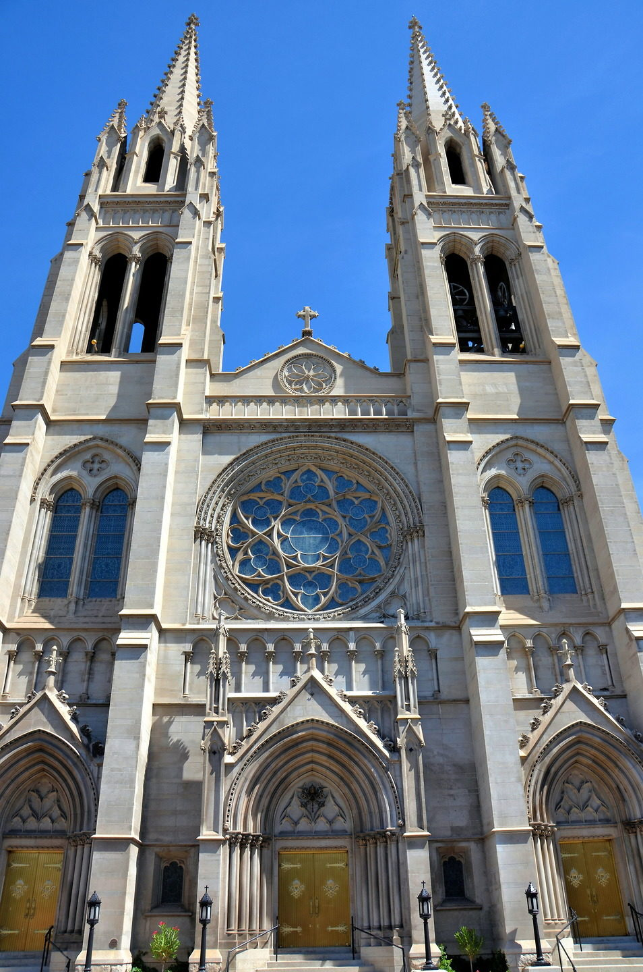
All-Hazards includes….
Medical incidents
Suspicious incidents
Disturbances
Property crimes
Person crimes
Irregular or large events
Construction & renovations
Many more…

Slide 79

Steps to Develop Safety & Security
Plan

Slide 80
Safety Team Development
Purpose and size of a Safety Team
  Develop culture of awareness and preparedness
  3-7, depending on size of parish
  Parish with a school – 1 team
Who make good team members – may include
  Clergy
  Staff
  Faculty
  Maintenance
  IT
  First Responder
  Parishioner
Typical team tasks
  Develop and maintain EOP
  Participate in safety assessments
  Ensure preventative maintenance is identified and completed

Slide 81

Emergency Operations Plan
Structured, all-hazards framework that outlines how the parish/school/apostolate will prepare for, respond to, and recover from emergencies, including roles and responsibilities, and written policies.
Who’s in charge and make decisions?
Who responds and how?
Who communicates the messages?
Training expectations

Slide 82

Reporting of Incidents
Who completes this report?
Pastors
Business Managers
Principal
Security Team Leader

Slide 83
When to complete this report
Category (1) | Security Incident Report | General Liability Claim Report | Worker’s Compensation Report | Property Claim Report (property or fine arts) | Volunteer Reporting (2)
Suspicious Activity | X
Disturbance | X
Medical Event | X | X | X |  | X
Property Crime | X | X |  | X
Persons Crime | X | X | X |  | X
Corresponds with the incident categories from SIR.
Represent which volunteer incidents should be reported.

Slide 84



THANK YOU!

Slide 85
When is it necessary to consult the Real Estate office and the Office of Design and Construction?

Slide 86
AOD Lease with Insurance Requirements
Archdiocese of Denver
Real Estate Department—Jarrett Laraway

Slide 87
Office of Real Estate
Jarrett Laraway, Director
Steve Cottingham, Real Estate Project Manager
Janet Droege, Real Estate Coordinator
Tiffany Franc, Real Estate Coordinator

Slide 88
Real Property, including Leasing Transactions
Consistent with both canon law and appropriate civil/secular laws, parish property is beneficially
owned by the respective parish or the Ecclesiastical Organization. Within the Archdiocese, all real
property is held in Trust by the Archdiocesan Corporation for the benefit of the parishes in the
territory of the Archdiocese and for certain Ecclesiastical Organizations; however, the beneficial
owner of parish property is the applicable parish or Ecclesiastical Organization as set forth in the
official records of the 25 different counties comprising the territory of the Archdiocese in the state
of Colorado.

Slide 89
Leases
All leases incumbering ecclesiastical property must go through the office of real estate. The office of real estate will prepare the lease on behalf of the parish or ecclesiastical entity.
  • The valid leasing of ecclesiastical goods owned by a parish or other public juridic person subject to the governance of the Archbishop requires consent of the Archbishop when the market value of the goods to be leased exceeds $100,000 or the lease is to be for one year or longer.
  • The valid leasing of ecclesiastical goods requires, in addition to the consent of the Archbhishop, requires real estate committee approval and finance council approval when the value of property to be leased exceeds $1,000,000 or the lease is to be for three years or longer.
  • The valid leasing of ecclesiastical goods by any public juridic person requires the consent
  of the Holy See when the market value of the goods exceeds $5,000,000.
For single use or low intensity use of ecclesiastical property, the Facility Usage License Agreement may be used.

Slide 90
Insurance Requirements for Leases
All lease insurance requirements can be found at Insurance Contract Matrix | Mission Support
  • Specific insurance requirements for types of lessee (office use, parking, school/daycare)
    Different uses require specific coverages, if to school/daycare must provide Sexual Misconduct Coverage.
  • Internal vs External Lessee (AOD Affiliated or 3rd Party)
    If AOD Affiliated, lease will reflect insurance deductible is the financial responsibility of the Lessee.
    If Lessee is a 3rd Party, prefer Lessor does not provide internet access. If so, Cyber Insurance is mandatory. It is usually cheaper for Lessee to obtain their own internet provider.
  The parish and AOD must me named on the policy. Parishes must obtain insurance certs and keep them on file for each year of the lease.
  Work with the AOD and Risk Management to make sure you have proper coverage. Lessee’s who do not obtain and maintain proper insurance are in default of the contract.
  Preventative Maintenance – Do no jeopardize insurance coverage. Lessee obligation, but parish must request information yearly.

Slide 91
Office of Design & Construction
David Wurzbach, Director
Mike Wisneski,
Project Manager
Gordon Schott,
Project Manager

Slide 92
Deferred Maintenance
“Hoping for a hailstorm” is not a maintenance plan.
Emphasis on major systems:
  Roof
  HVAC
  Exterior Façade
  Parking lots & flatwork
Particular risks in Denver: Green Roofs & Electrification

Slide 93
Facilities Condition Assessments
Understand your exposure & plan your upcoming costs
Open market & in-house options available
  Lerch Bates
  McKinstry
  AoD

Slide 94
Stretching Your Dollar
Service agreements!
Relationships – save money now and later!

Slide 95
Break – 15 minutes

Slide 96
How often are asbestos reinspection visits required by Colorado state law?

Slide 97
Schools and Parish Business Managers
Mark Strawbridge
  AHERA Compliance
  AEDs
  Safety and Security
  Other

Slide 98
Asbestos Management Plan – AHERA
1600 Asbestos Management Plan.pdf
Please see your School Resources Page given to principals and school leaders in August
AHERA communication to community – in school Family Handbook
AHERA binder located, documents checked
Maintenance Personnel must take a 2-hour training, info in the Resources Guide
AHERA Log Form.xlsx (fill out and place in the front binder)

Slide 99
Asbestos Management Plan – Accountability
Activity | Archdiocese Risk Management/OCS/Real Estate | Principal | Business Manager | AHERA Designated Person | Consultant
Governance and policy | A/R (RM and OCS) | A | I | I | C
Management plan maintenance | C | I | A | R | C
Triennial reinspection | C | I | A | R | R
Periodic surveillance | I | I | A | R | C
Annual notification | C | A | A | R | C
Capital project/construction review | A (Real Estate) | C | C | R | C
Regulatory records | C | A | A | R | C
R = Responsible—does the work
A = Accountable—owns the outcome
C = Consulted—provide expertise before action is taken
I = Informed—need awareness but do not make decisions or perform the work

Slide 100
AED Policy-Compliance with SB25-191: Cardiac Emergency Plans for Schools
Response Time: AED access within 3 minutes of a cardiac event
Accessibility: Place AED in visible unlocked locations near gyms, athletic fields and high-traffic areas
Signage: Clearly mark AED locations with standardized signs
Maintenance: Check battery and electrode pad expiration dates regularly; perform monthly visual inspections and document

Slide 101
Safety and Security
School Emergency Operations Plans (EOP) are due to Deacon Daly by March 24 (Spring Break)
Important to have Parishes on the same page with the school
Standard Response Protocol (SRP)

Slide 102
Miscellaneous Topics
Risk Management Manual
2027 Risk Management Day meetings
Meeting Evaluation Survey

Slide 103
Questions?
Risk management in an apostolic age is more important than ever. Risk is ever-present and can never be totally eliminated. Recognizing that not all risk is bad and with the correct processes and oversight in place you can manage risk and the financial, reputational, and operational effects it has on parish mission.
  Identify risk in your Parish
  Assess the impact risk can have
  Develop solid mitigation/management strategies
  Monitor and communicate throughout the parish

Slide 104
Adjourn

